Slide 1
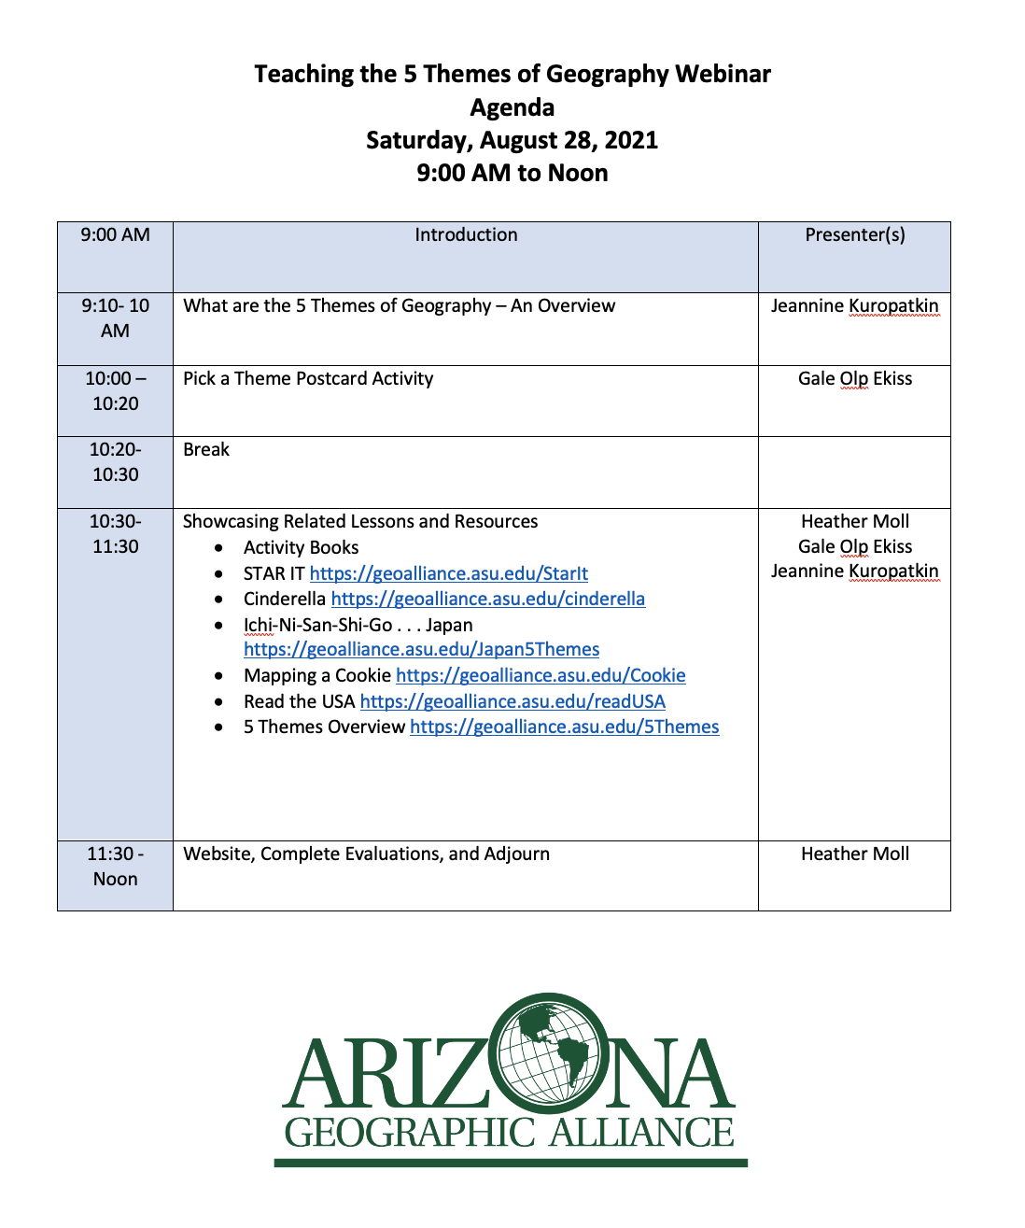

Slide 2
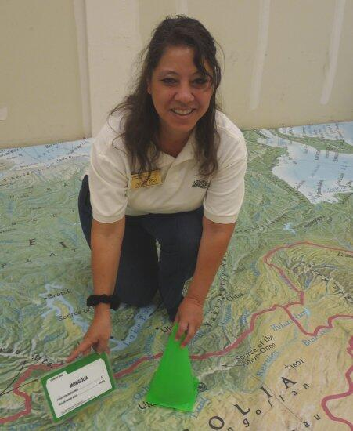



Teaching the 5 Themes of Geography
Jeannine Kuropatkin
Heather Moll
Gale Olp Ekiss
https://geoalliance.asu.edu/

Slide 3
Showcasing 7 resources on our website
Activity Books https://geoalliance.asu.edu/activitybooks
STAR IT https://geoalliance.asu.edu/StarIt
Cinderella https://geoalliance.asu.edu/cinderella
Ichi-Ni-San-Shi-Go . . . Japan https://geoalliance.asu.edu/Japan5Themes
Mapping a Cookie https://geoalliance.asu.edu/Cookie
5 Themes Overview https://geoalliance.asu.edu/5Themes
Read the USA https://geoalliance.asu.edu/readUSA

Slide 4
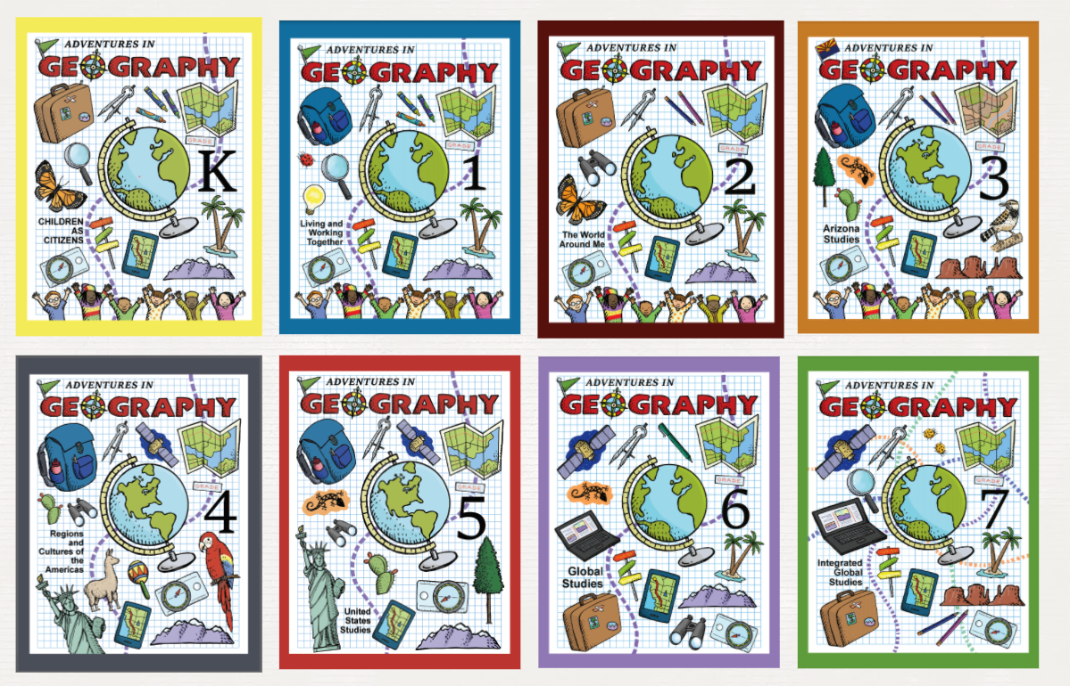
Activity Books
Summer of 2020 AzGA Teacher Consultants created stand alone activity books.
Many of these activities reference the 5 Themes of Geography.
They come in print, and pdf form.

Slide 5
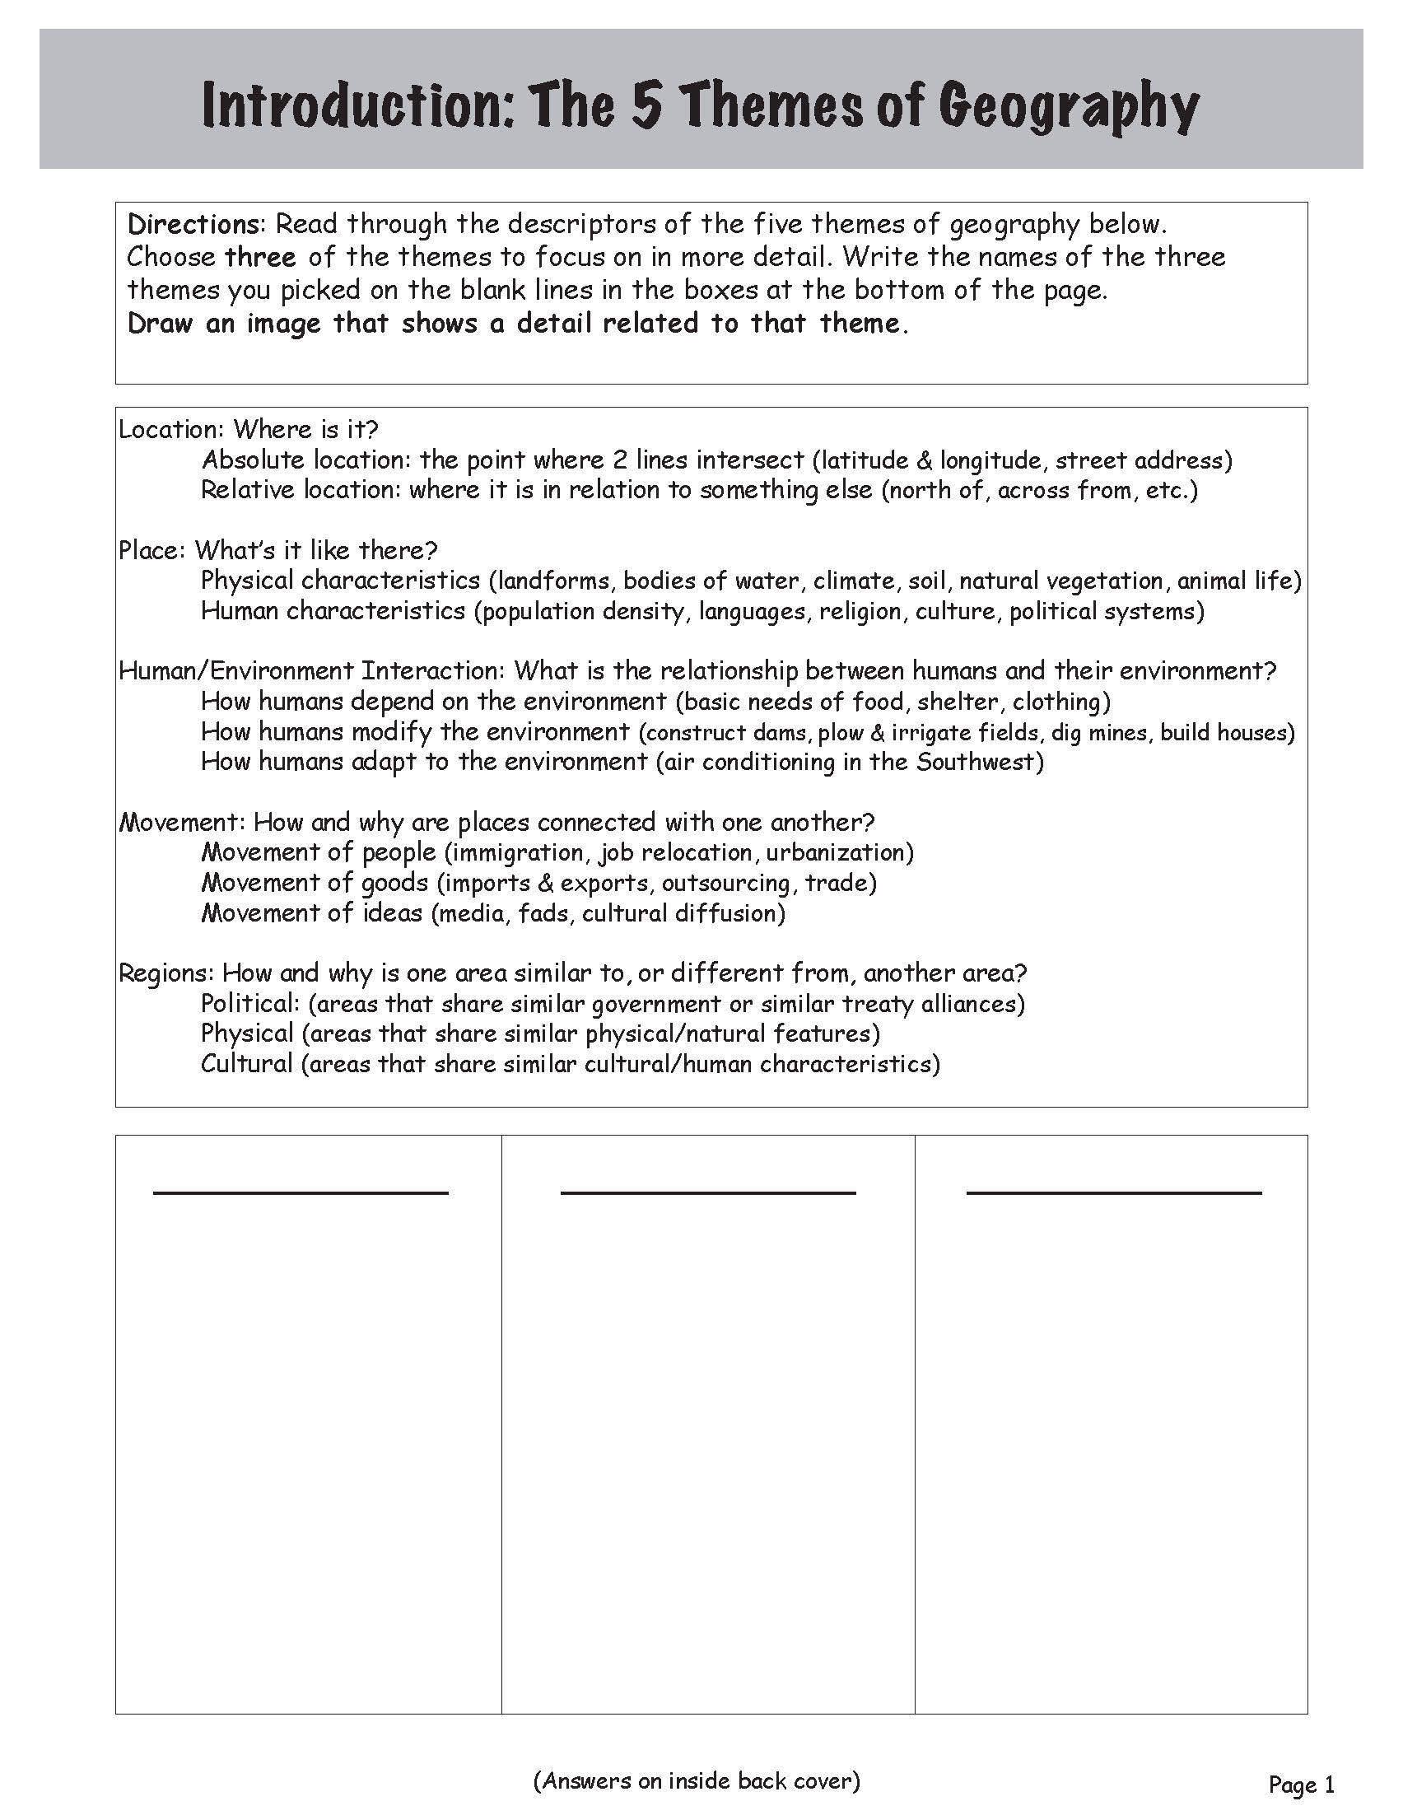
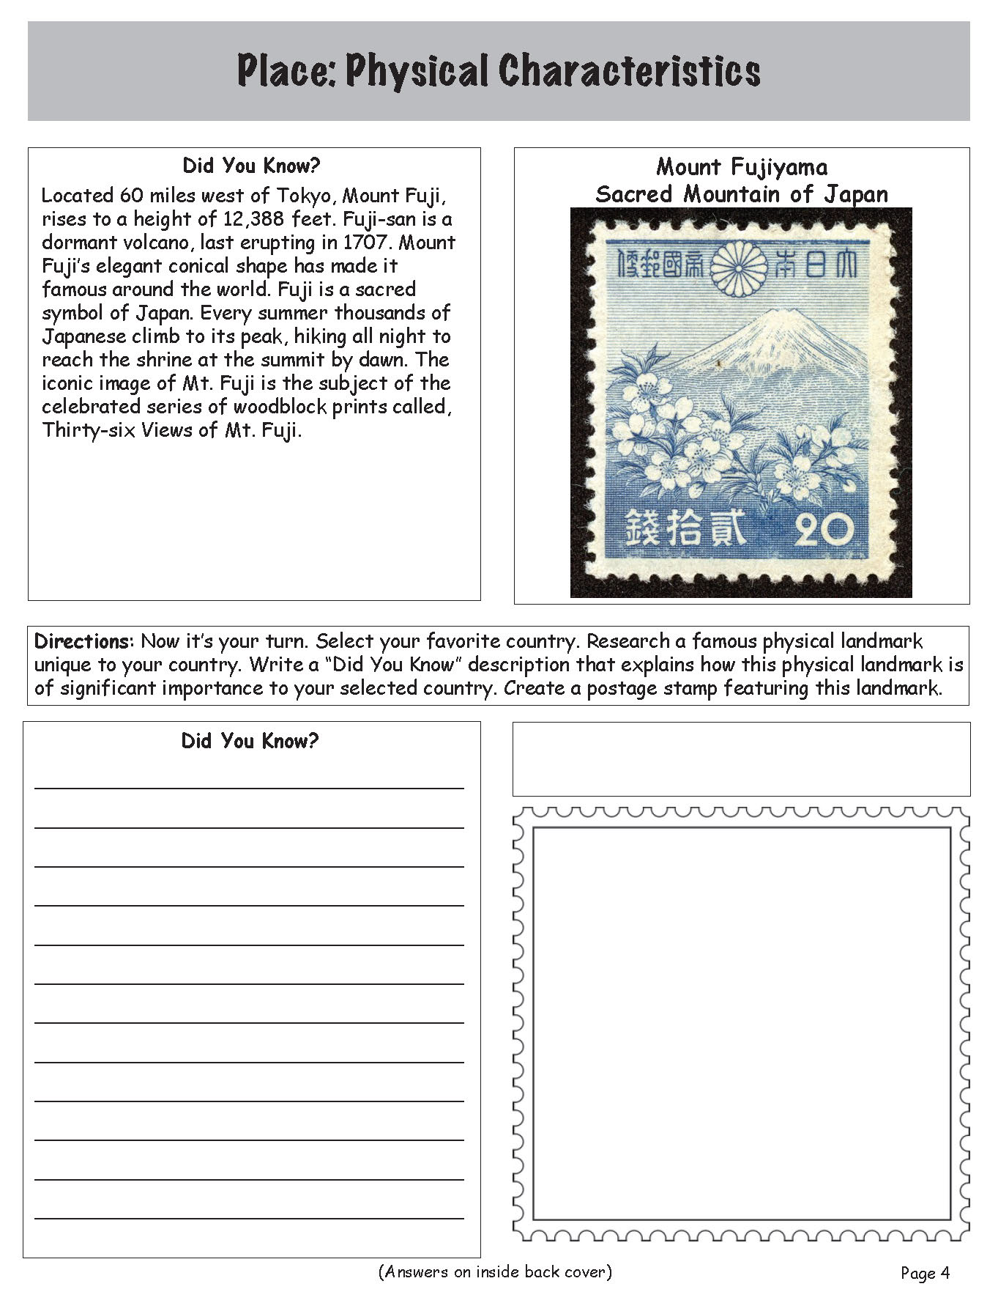
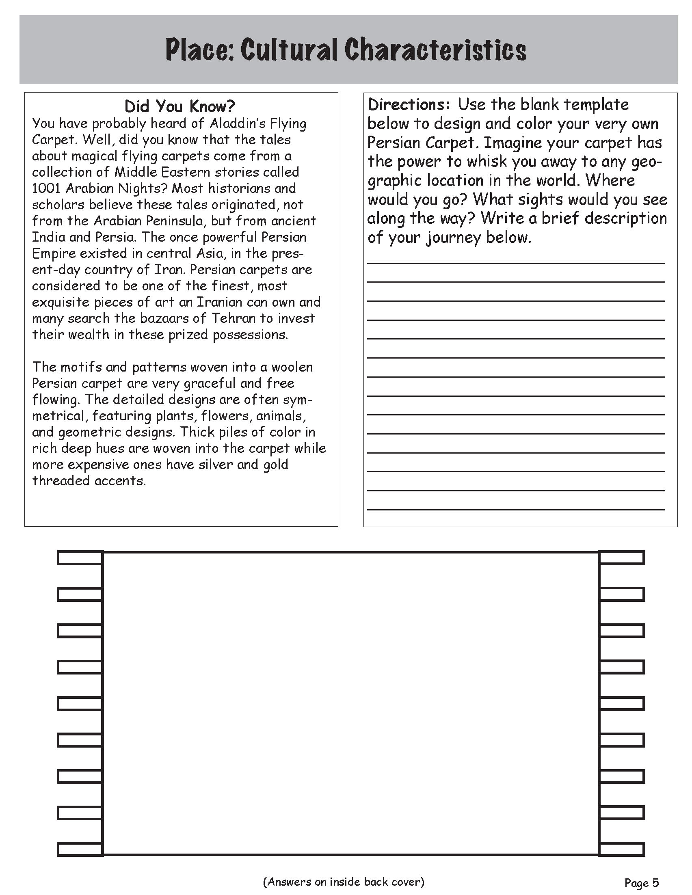
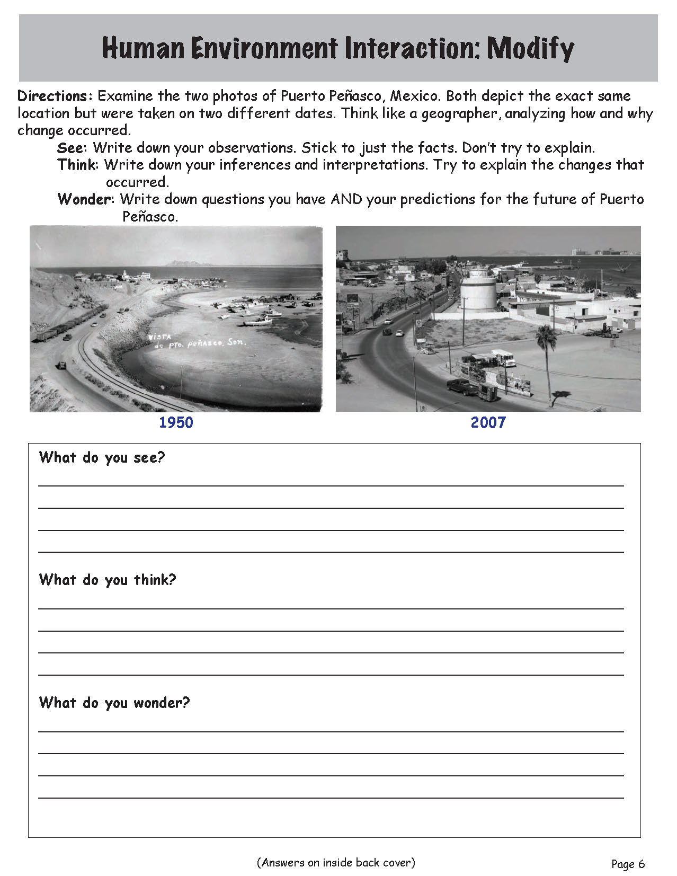
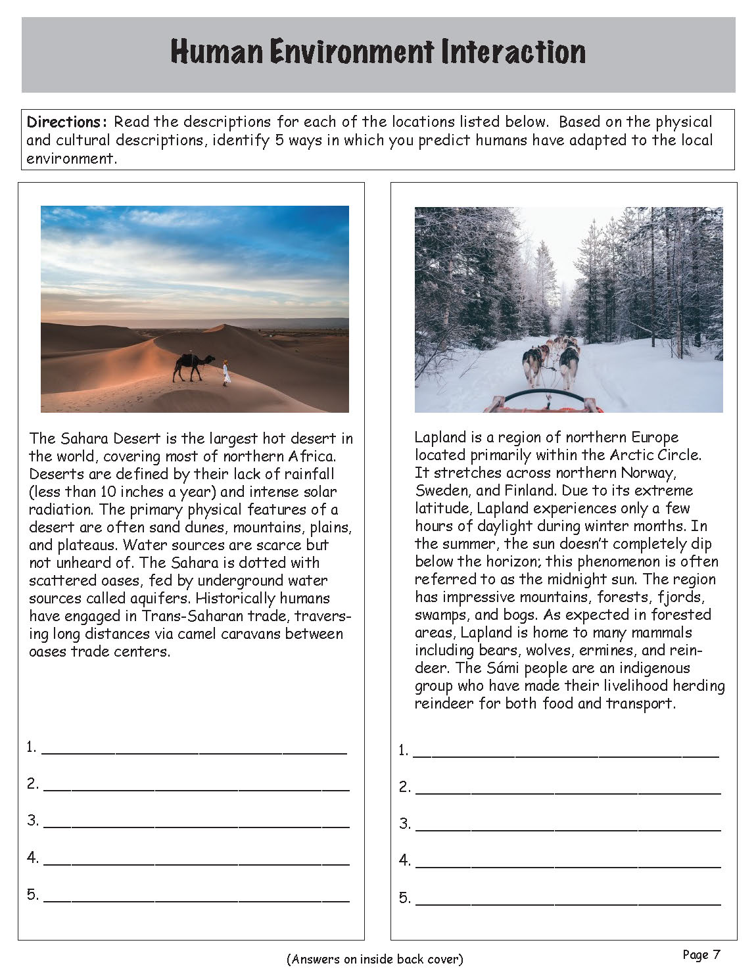
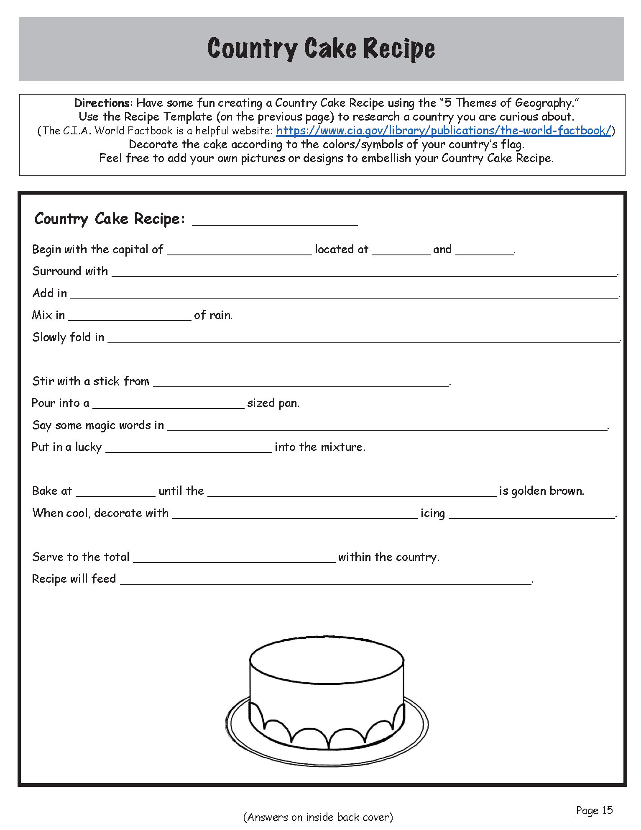
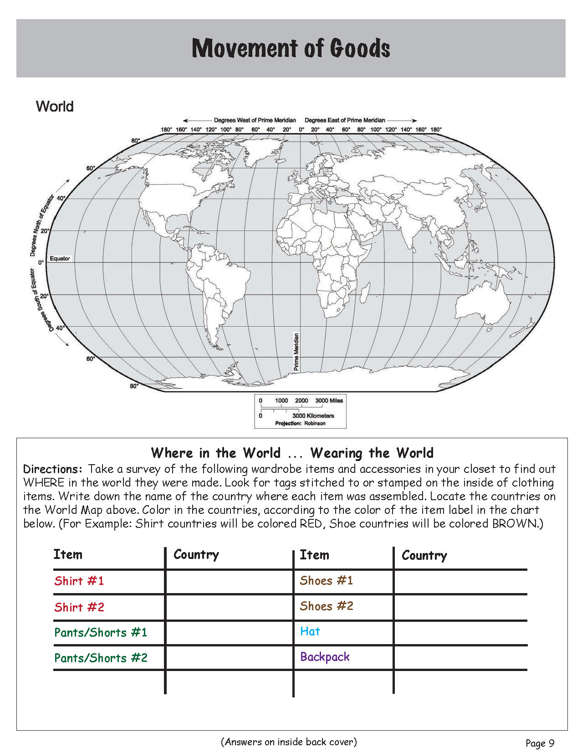
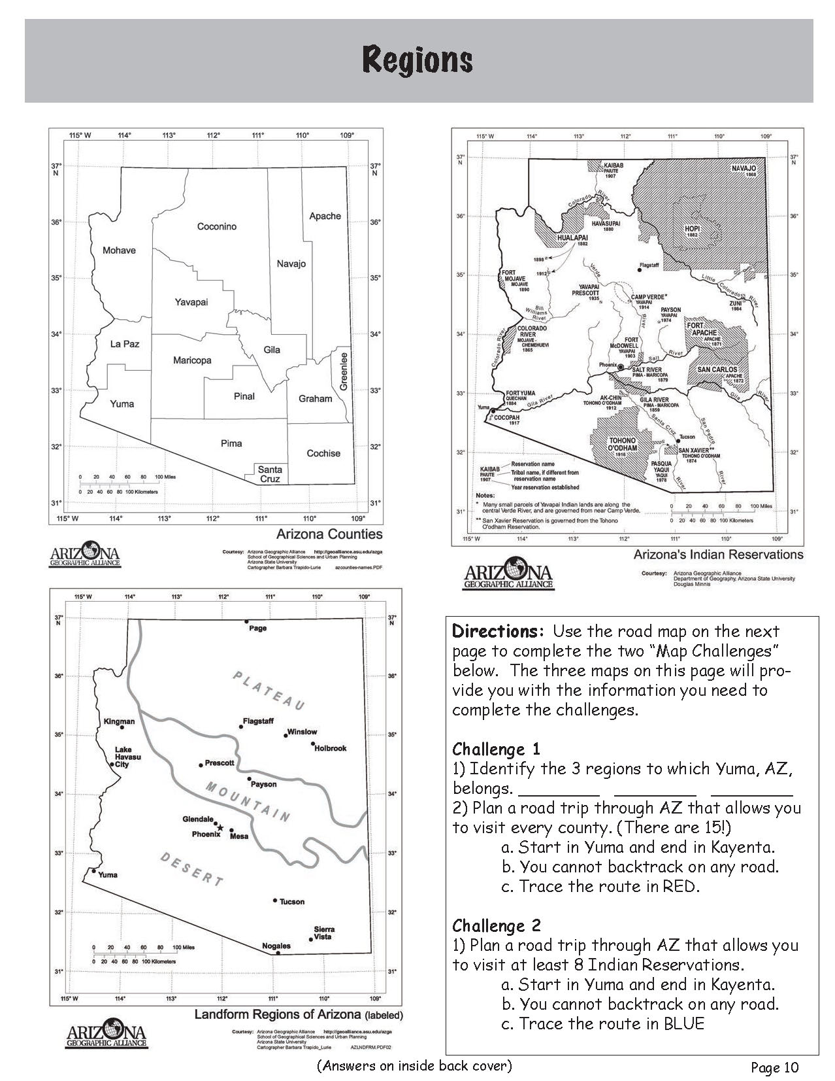
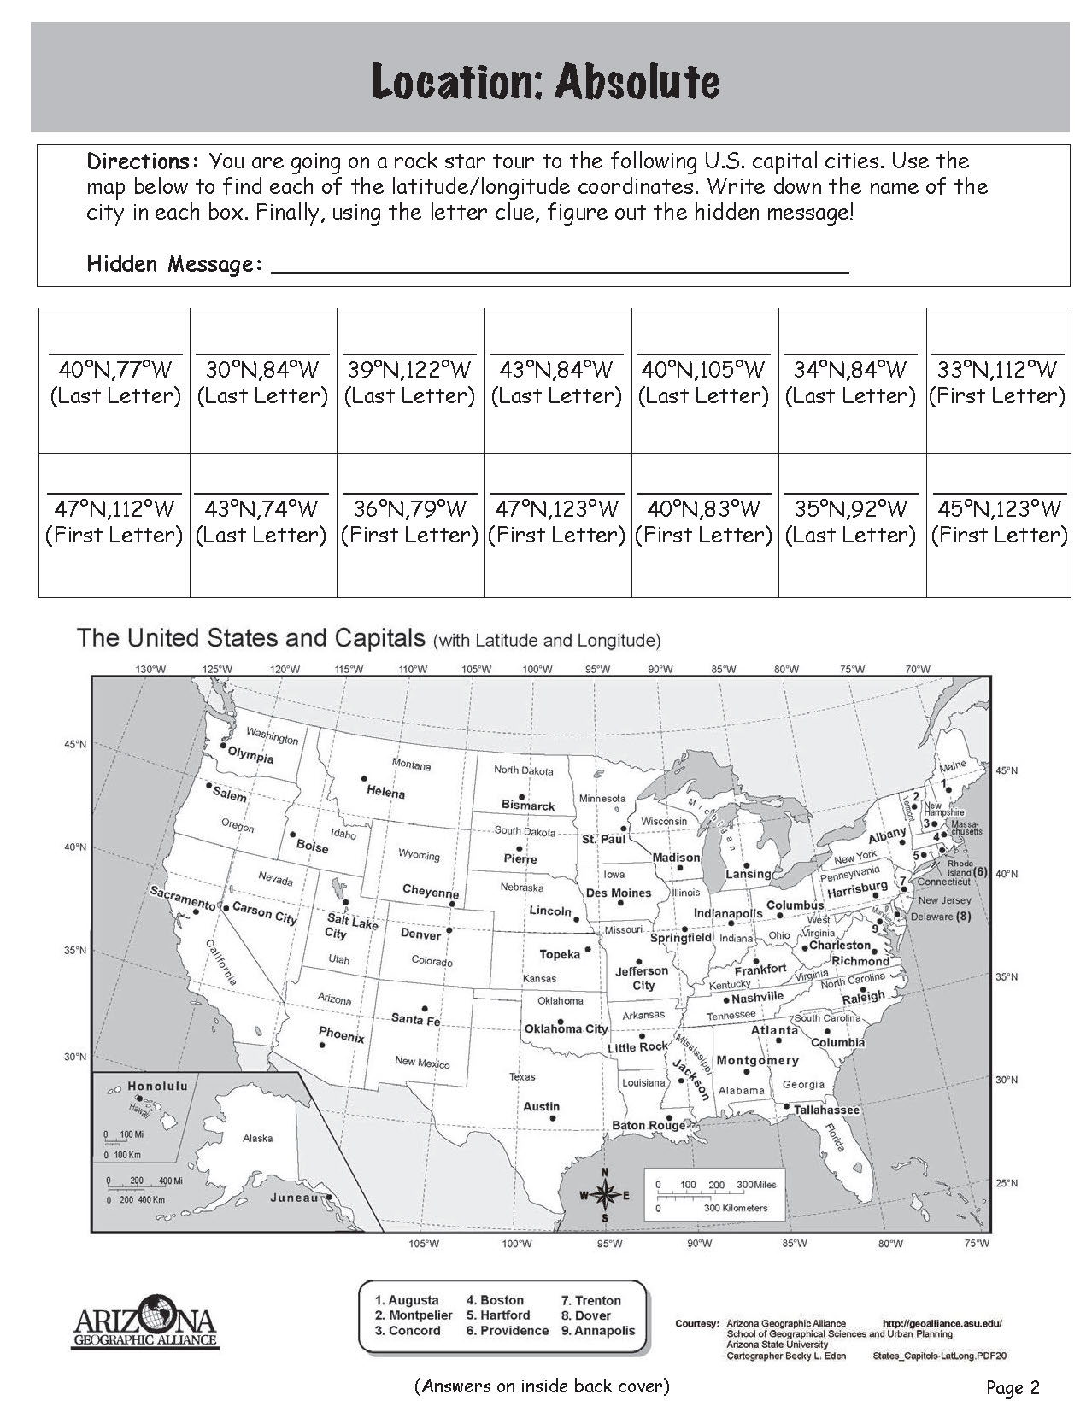
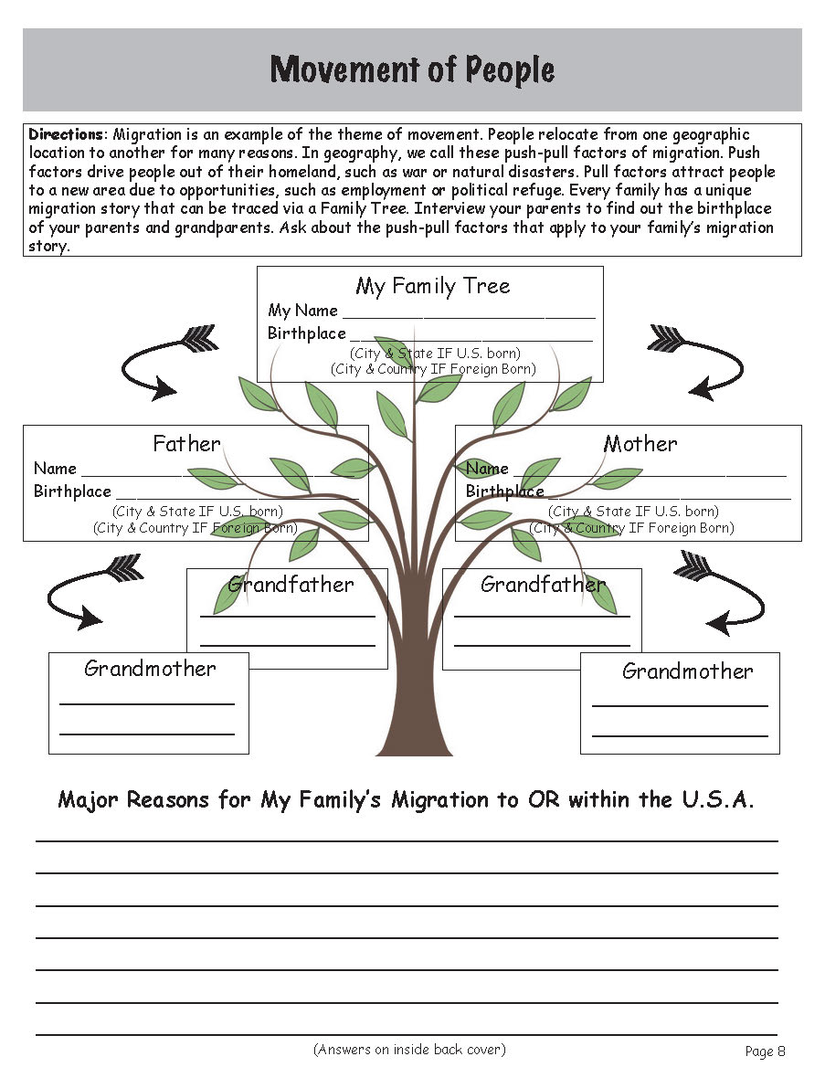
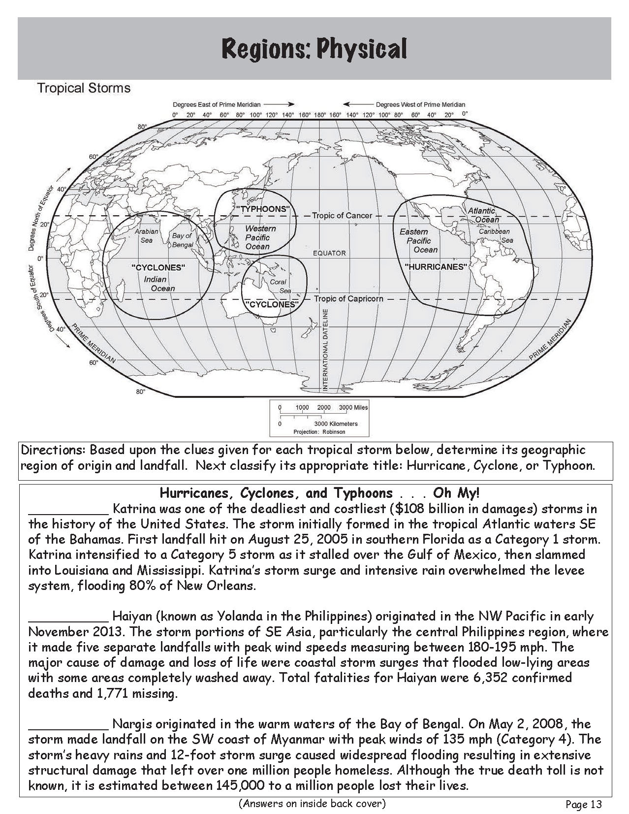

Slide 6
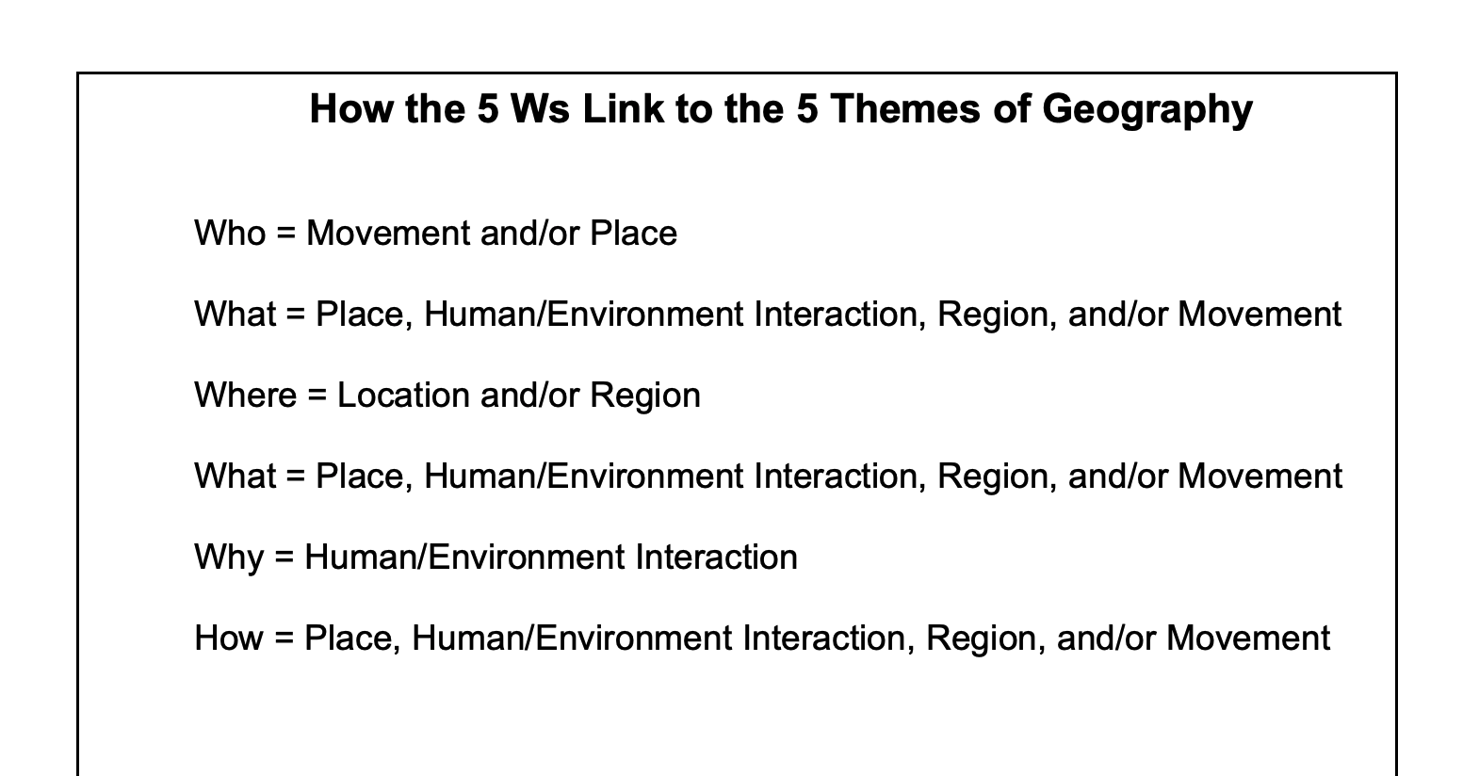
STAR IT: Simplify the article’s really important topic
By: Barbara Martin
Grades 6-8 (but I think you can even go higher)
Purpose: The purpose of the lesson is to have the students incorporate what they already know from one discipline, geography, into the areas of reading and writing.
The students will learn how the Five Themes of Geography fit into the Five Ws: Who, What, Where, When, Why, and How.

Slide 7
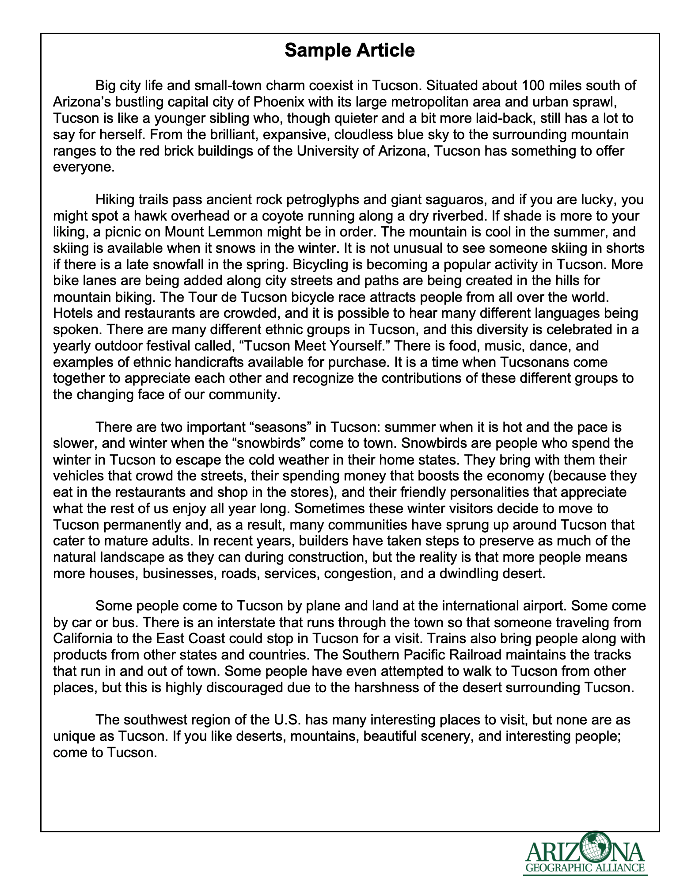
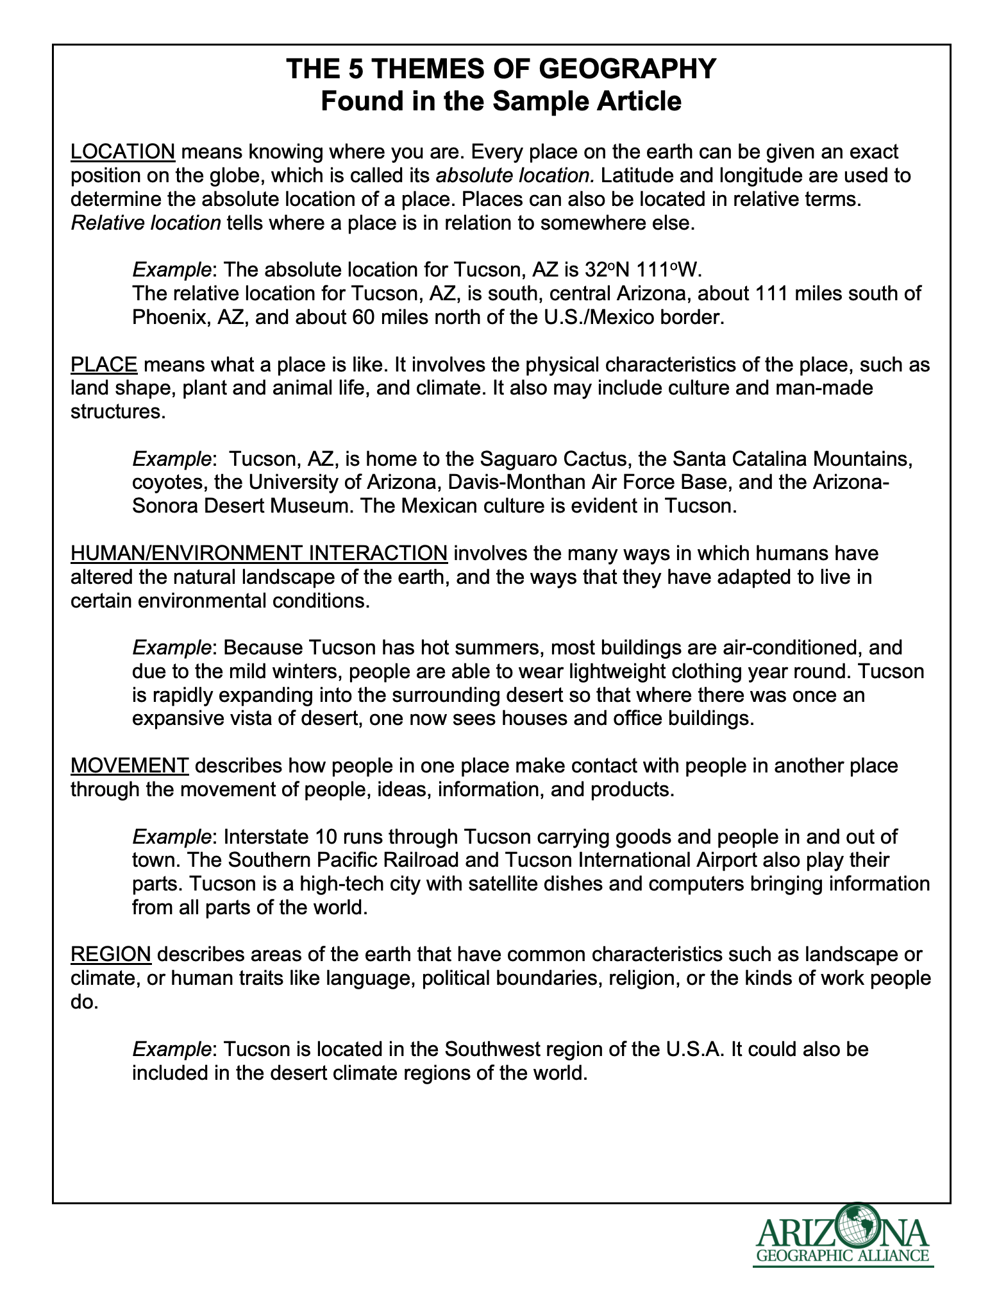


STAR IT: Simplify the article’s really important topic
Distribute 5 colors of colored pencils or highlighters to each student.
Assign a color to each of the themes (ex. Location = brown). Use the sample article and read as a class. Have students highlight or underline the 5 Themes as they are mentioned.

Slide 8
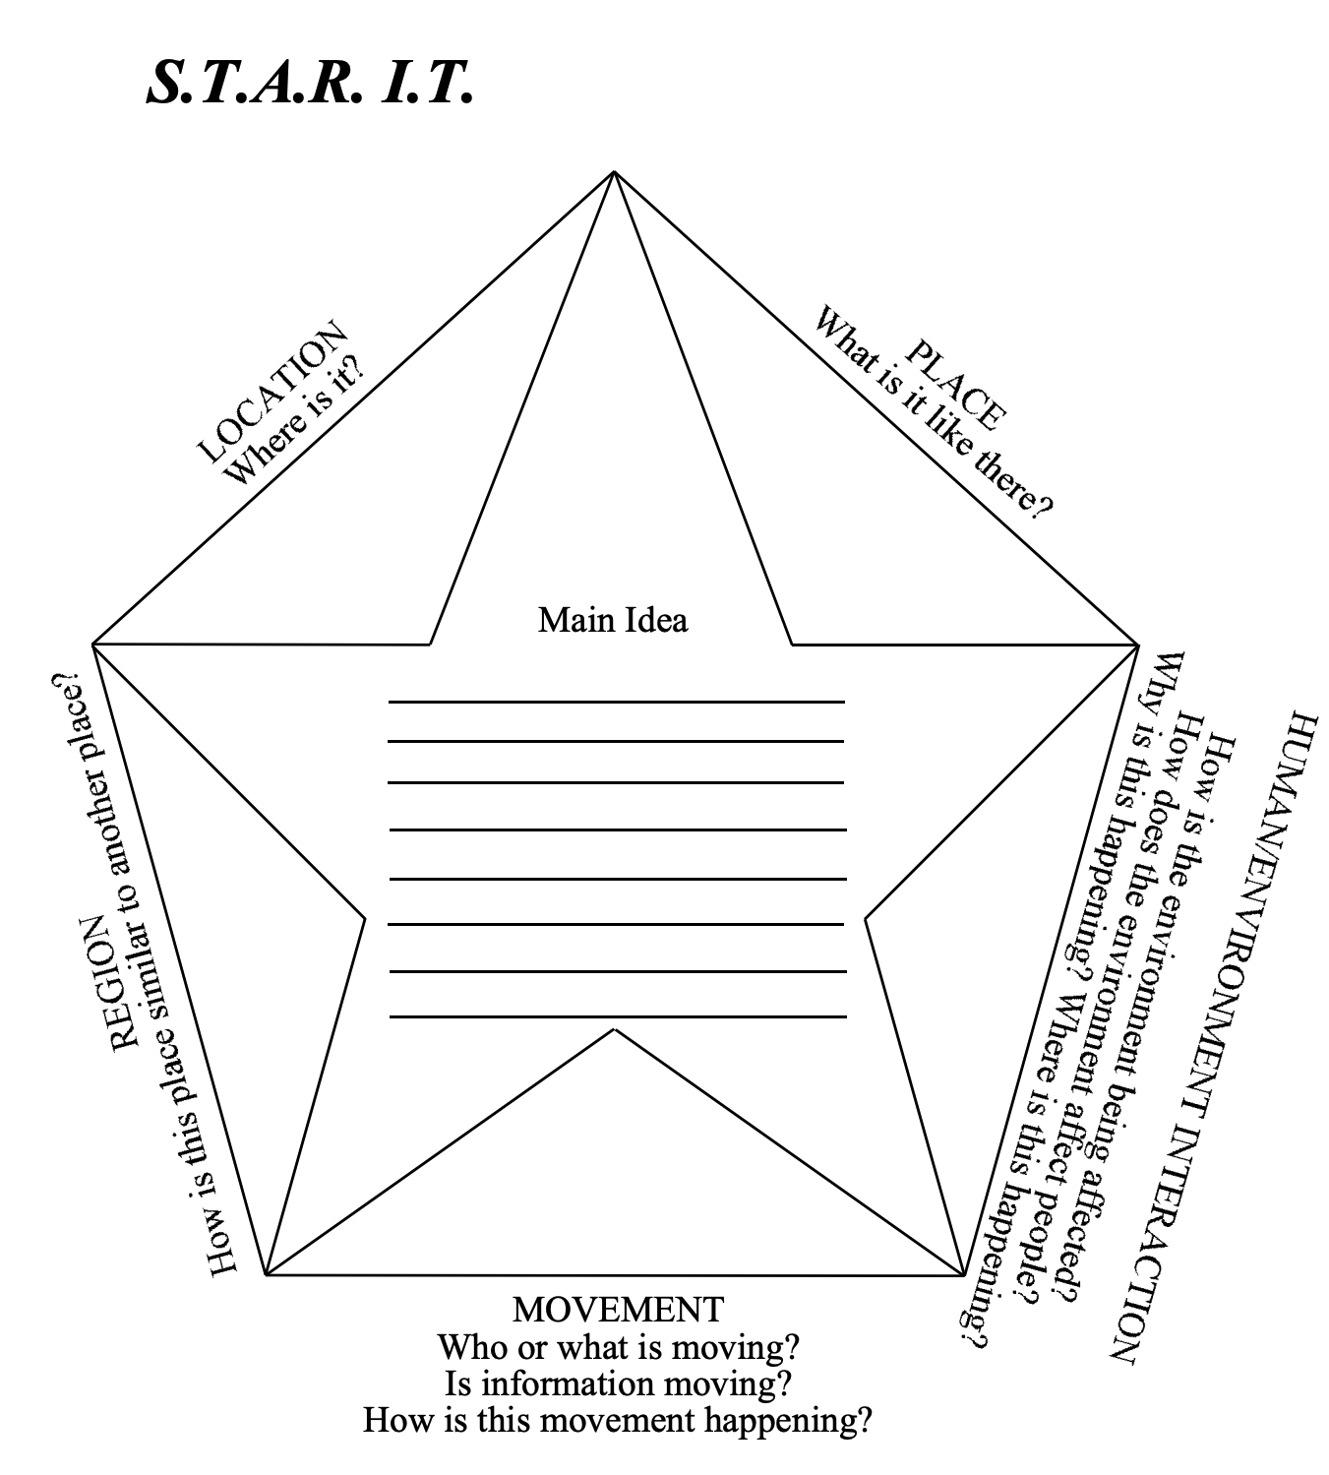
STAR IT: Simplify the article’s really important topic
Prior to Session Two: Students need to find a current event story that deals with Human/Environment Interaction (earthquake, heat wave, drilling for oil, new road to be built, etc.).
Project the STAR IT graphic organizer and explain how to use it.
Have students use their current event story to complete the graphic organizer. Have students trade with a partner to get feedback on what to edit.
After editing, have students write a short summary stating the main idea of the article.

Slide 9


STAR IT: Simplify the article’s really important topic
In the Chat Box, write whether you would use this lesson in your classroom.
Yes
No

Slide 10
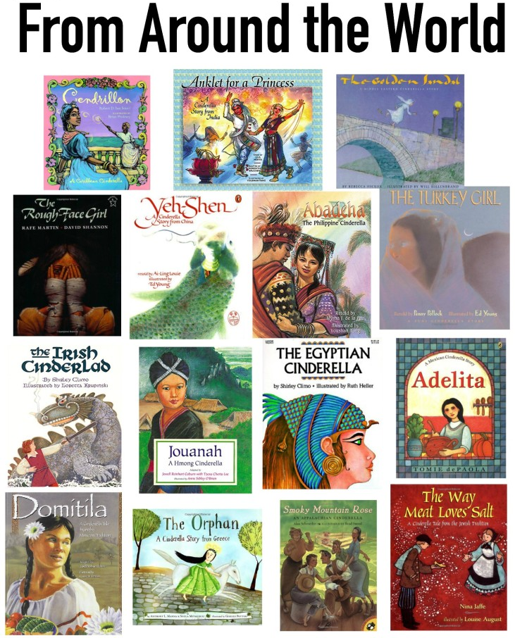
Cinderella around the world
By: Karen Guerrero
Grade 6
Purpose: In this lesson, students will explore the places and regions around the world through multicultural Cinderella Stories. While reading the stories, students will not only review literary elements of traditional literature, they will identify the five themes of geography. They will then complete additional research to present their Cinderella stories through a visual representation of the story and its country of origin

Slide 11
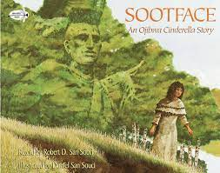

Cinderella around the world
By: Karen Guerrero
Do a pass-around to have small groups of students retell their knowledge of the traditional Cinderella story.
Have each student write one sentence then pass the paper until their group feels the story is complete. Have groups share out their stories; listening for similarities and make clarifications.
Tell the students they are going to listen to a variation of the Cinderella story. They need to listen for differences between the variant and original Cinderella story.
Read one version of the Cinderella story. (I recommend Sootface An Ojibwa Cinderella Story by San Souci or Yeh Shen A Chinese Cinderella by Aai-Ling Louie because these books give clear examples for the Five Themes of Geography.)

Slide 12
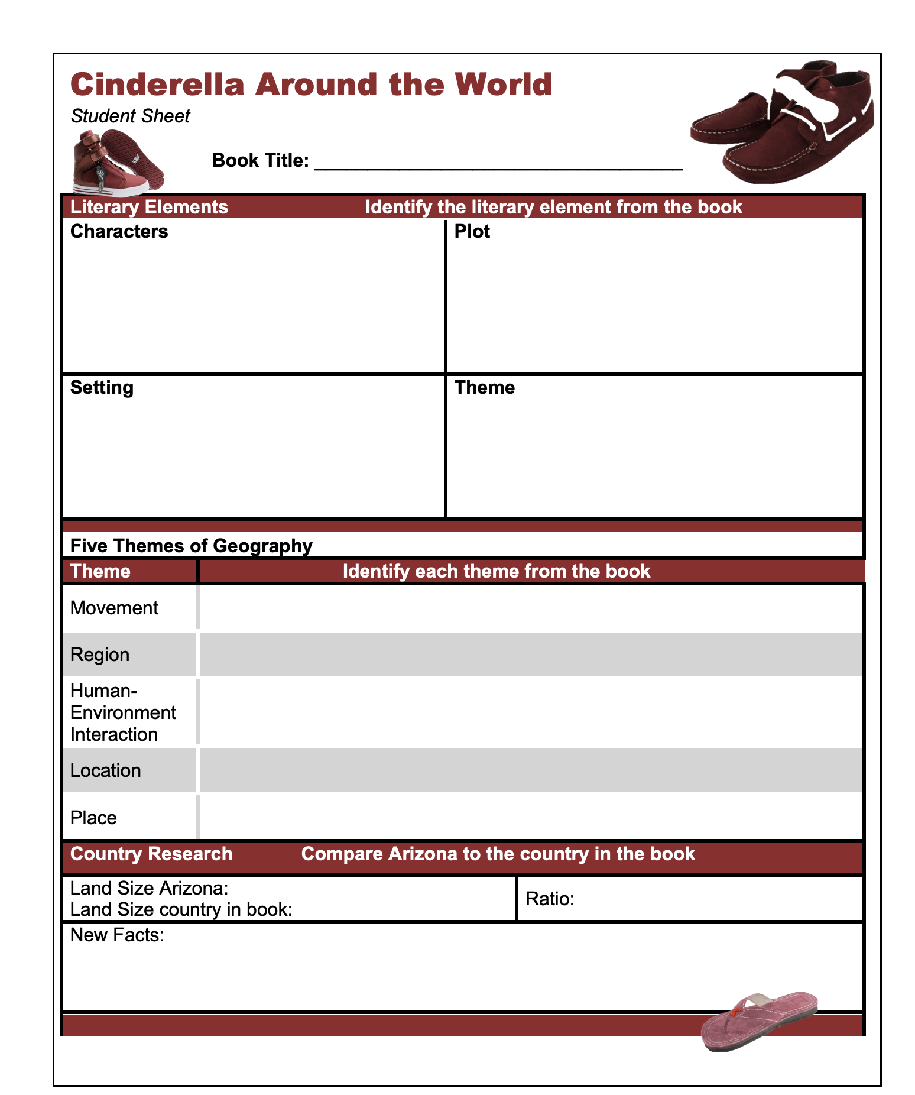
Cinderella around the world
By: Karen Guerrero
Provide a variant Cinderella story to each pair or small group of students.
Have them complete the student page including literary elements, Five Themes of Geography and additional research on the country where the story takes place.
They should also know the location of their country on a world map.
Have students use an almanac to research the land size of the country in which their Cinderella story takes place and the land size of Arizona. Have them create a ratio of how many Arizonas fit into their country or how many of their countries fit into Arizona (depending on which one is bigger).

Slide 13

Cinderella around the world
By: Karen Guerrero
In the Chat Box, write whether you would use this lesson in your classroom.
Yes
No

Slide 14
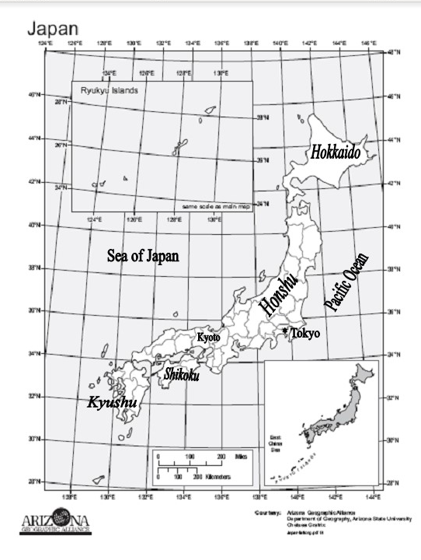
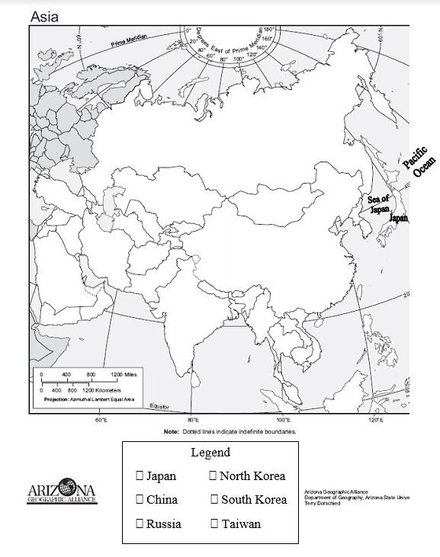
Ichi-Ni-san-shi-go . . . Japan!
Studying Japan using the 5 themes of geography
By Jeannine Kuropatkin
Grades 6-7 (Used in HS)
Session One
Procedures:
1. Introduce Japan through map activities & the theme of Location

Slide 15
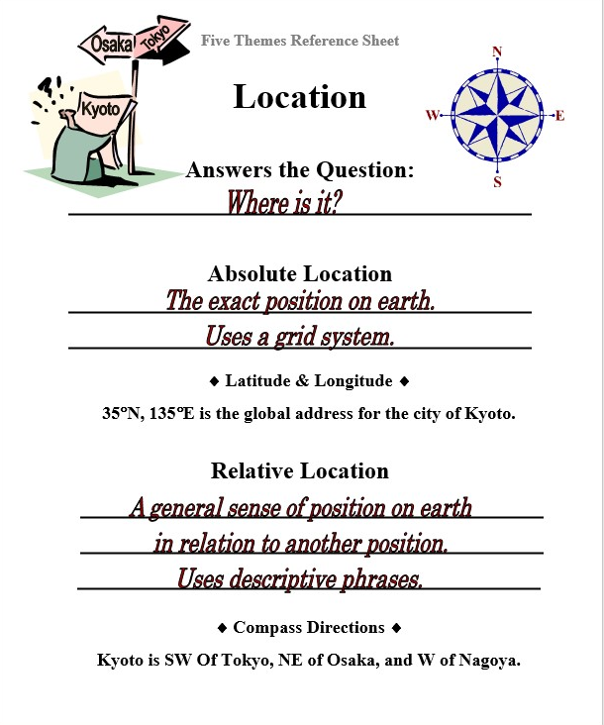
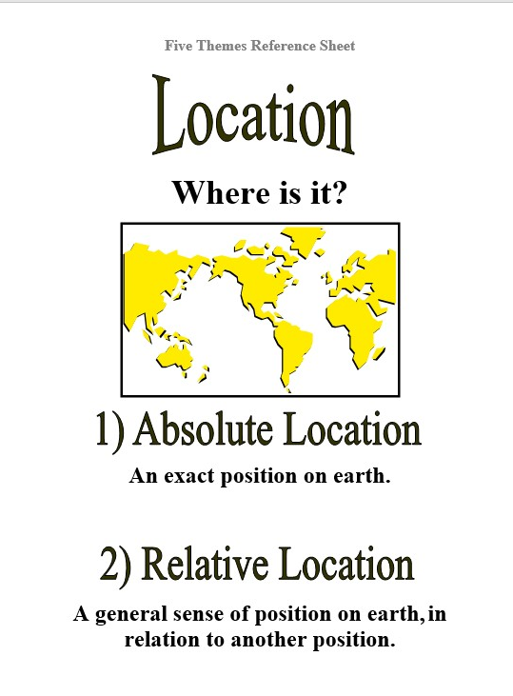
Ichi-Ni-san-shi-go . . . Japan!
Studying Japan using the 5 themes of geography
By Jeannine Kuropatkin
2. “5 Themes of Geography” Reference Sheets
Teacher explains EACH of the “5 Themes” using Japan examples
Students complete scaffolded notes on the “5 Themes” Reference Sheets

Slide 16
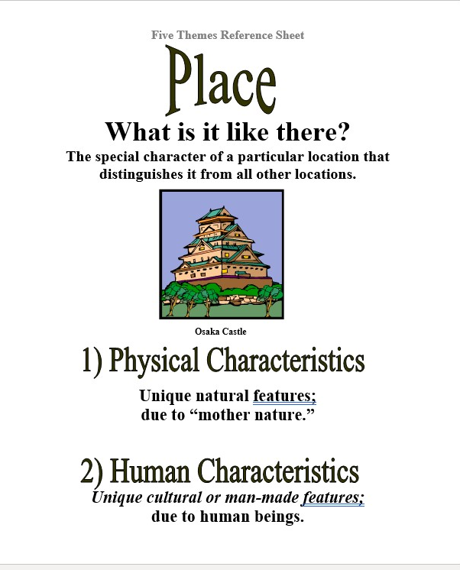
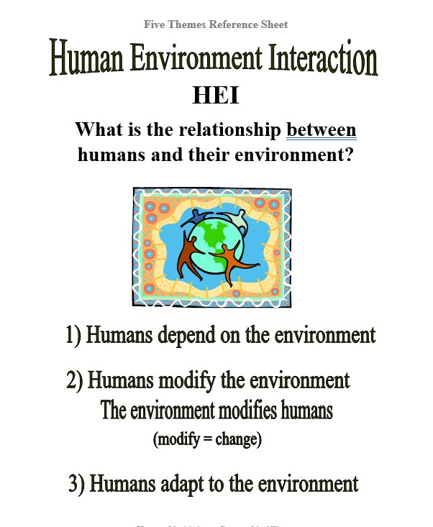
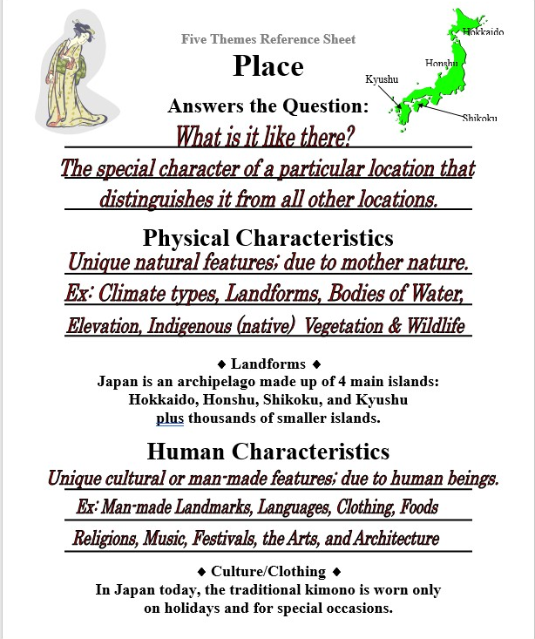
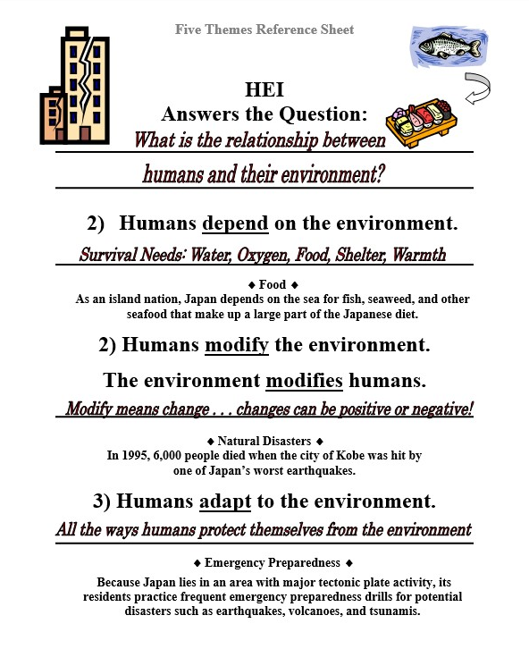
Ichi-Ni-san-shi-go . . . Japan!
Studying Japan using the 5 themes of geography
By Jeannine Kuropatkin

Slide 17
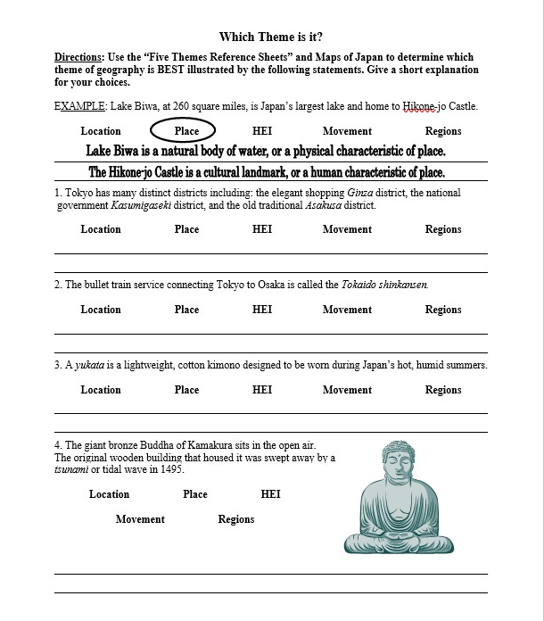
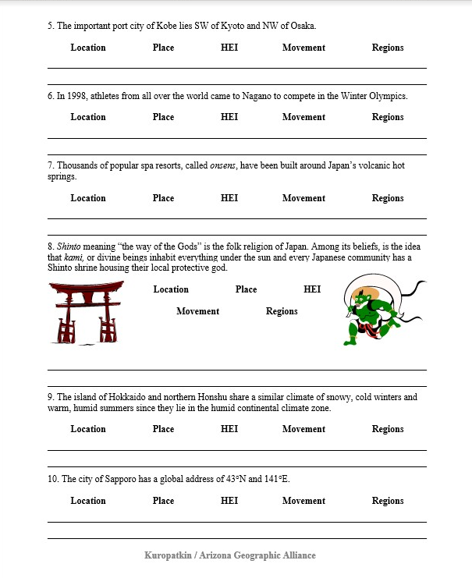
Ichi-Ni-san-shi-go . . . Japan!
Studying Japan using the 5 themes of geography
By Jeannine Kuropatkin
3. Students Pair/Share to complete “Which Theme is it?” Formative Assessment.

Slide 18
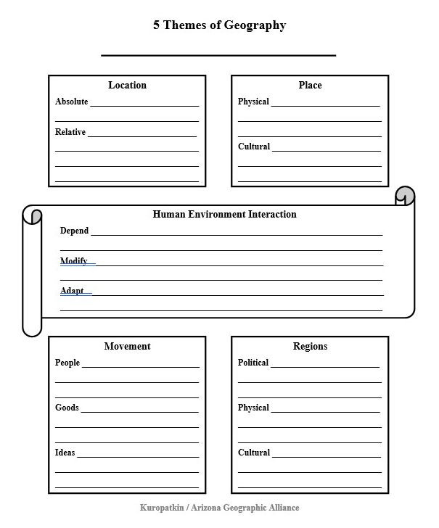
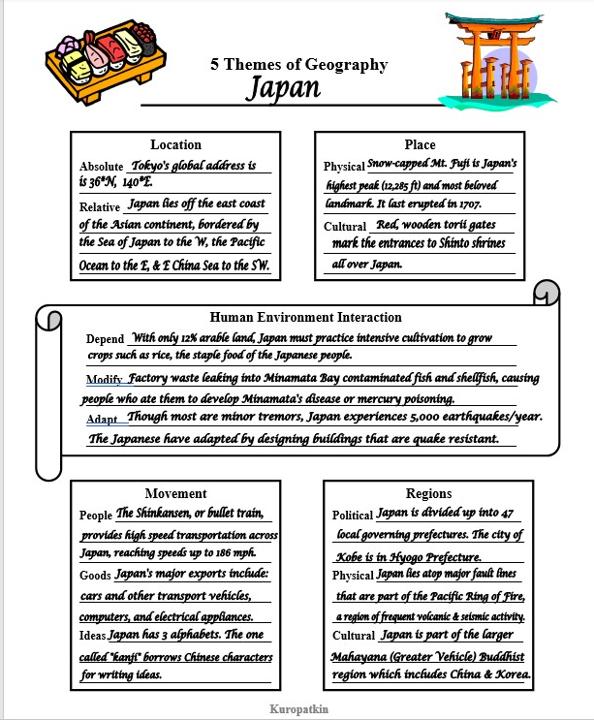
Ichi-Ni-san-shi-go . . . Japan!
Studying Japan using the 5 themes of geography
By Jeannine Kuropatkin
4. Teacher explains the “5 Themes” Graphic Organizer and “Mini-Poster Project”
Share templates
Share examples

Slide 19
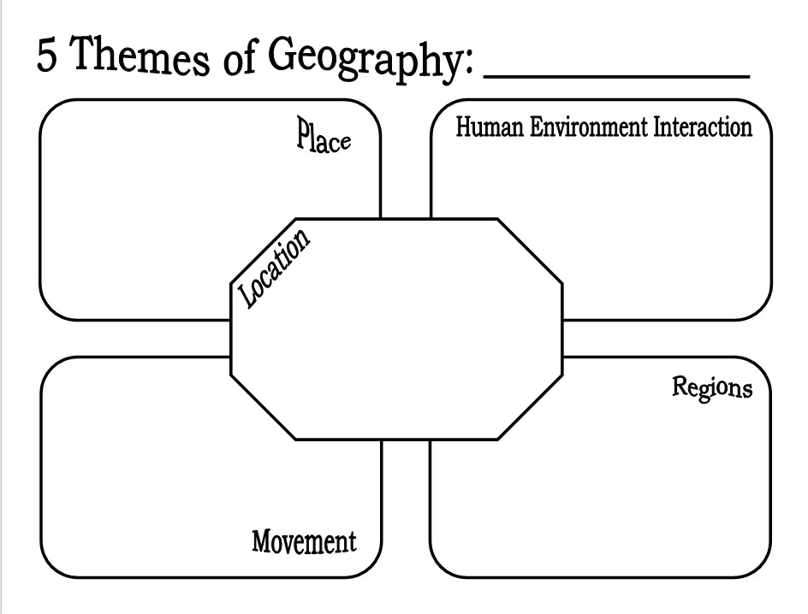
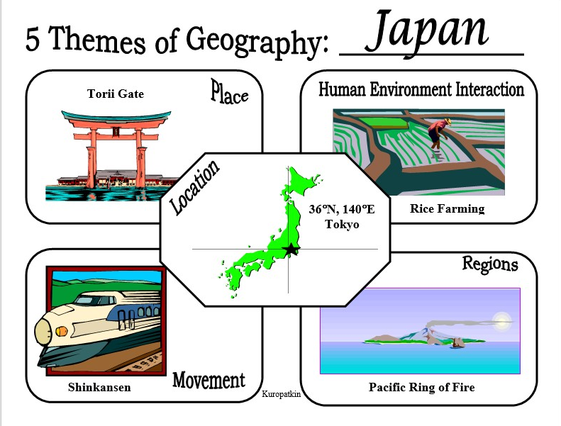
Ichi-Ni-san-shi-go . . . Japan!
Studying Japan using the 5 themes of geography
By Jeannine Kuropatkin
4. Teacher explains the “5 Themes” Graphic Organizer and “Mini-Poster Project”
Share templates
Share examples

Slide 20
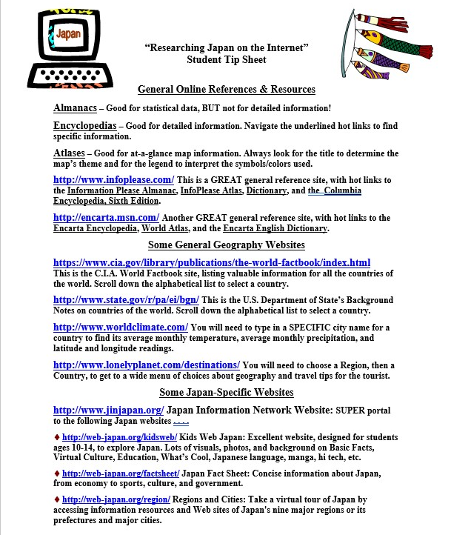
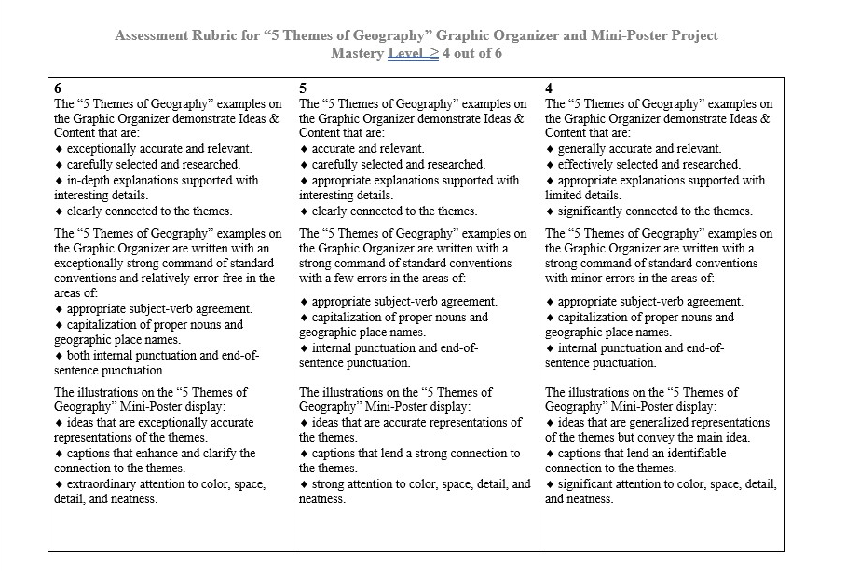
Ichi-Ni-san-shi-go . . . Japan!
Studying Japan using the 5 themes of geography
By Jeannine Kuropatkin
5. Teacher shares the “5 Themes” Graphic Organizer and “Mini-Poster Project” Rubric
6. Teacher shares the Internet Student Tip Sheet
7. Students Research and create their own Graphic Organizer and Mini-Poster
Assessment Rubric

Slide 21
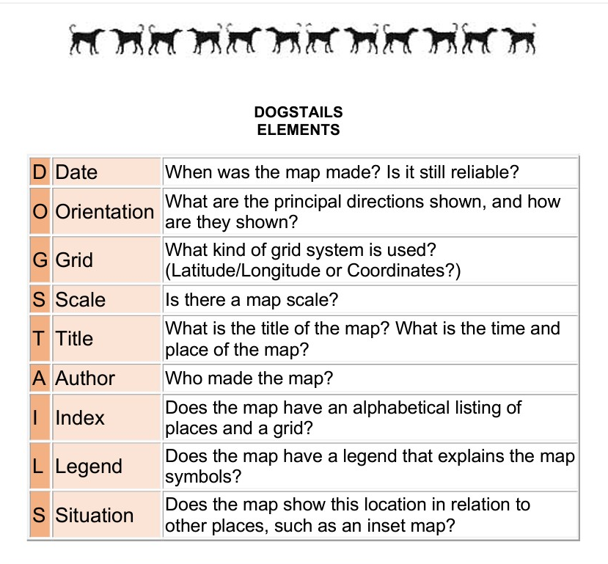
Mapping a cookie:
Applying the 5 Themes of Geography and DOGSTAILS
By Jeannine Kuropatkin
Grades 2-12
Procedures:
PreRequisite #1: Students should be familiar with and have mastery of the DOGSTAILS 9 Elements of Maps
https://geoalliance.asu.edu/dogstails

Slide 22
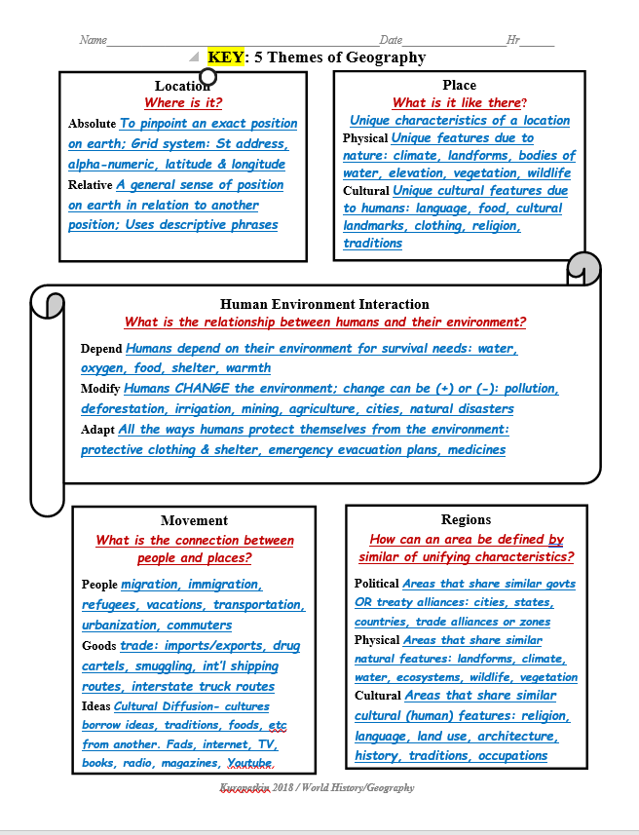
Mapping a cookie:
Applying the 5 Themes of Geography and DOGSTAILS
By Jeannine Kuropatkin
Procedures:
PreRequisite #2: Students should have mastery of the ”5 Themes of Geography”
Location
Place
Human Environment Interaction
Movement
Regions

Slide 23
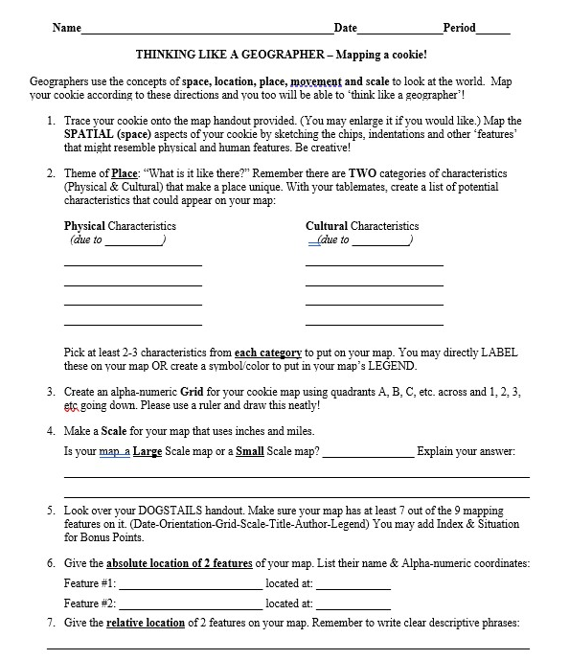
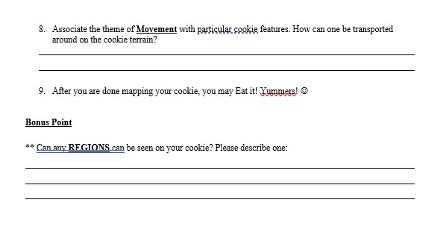

Mapping a cookie:
Applying the 5 Themes of Geography and DOGSTAILS
By Jeannine Kuropatkin
Procedures:
Teacher distributes the “Thinking Like a Geographer—Mapping a Cookie” worksheet.
Teacher explains that students will receive a cookie and they must map their cookie according to the directions on the worksheet.

Slide 24
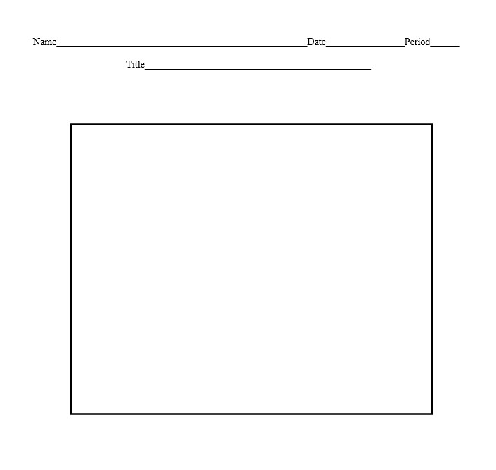


Mapping a cookie:
Applying the 5 Themes of Geography and DOGSTAILS
By Jeannine Kuropatkin
Procedures:
3. Each Student receives a cookie to map.
Recommend: Chocolate Chip with M&M’s
4. Draw the map on page 3 of the Handout.

Slide 25
Mapping a cookie:
Applying the 5 Themes of Geography and DOGSTAILS
By Jeannine Kuropatkin
Procedures:
5. The Thinking Like a Geographer—Mapping a Cookie worksheet and resulting map can be graded for completeness and accuracy.
Geography: Mastery will be considered 7 of the 9 DOGSTAILS elements correctly done on the map. Mastery will be considered 80% or higher on the spatial analysis components found on the worksheet.
Writing: The Thinking Like a Geographer—Mapping a Cookie worksheet questions 2, 6, 7, and 8 can be graded for evidence that supports analysis, reflection, and research. Mastery will be considered 80% or higher.

Slide 26
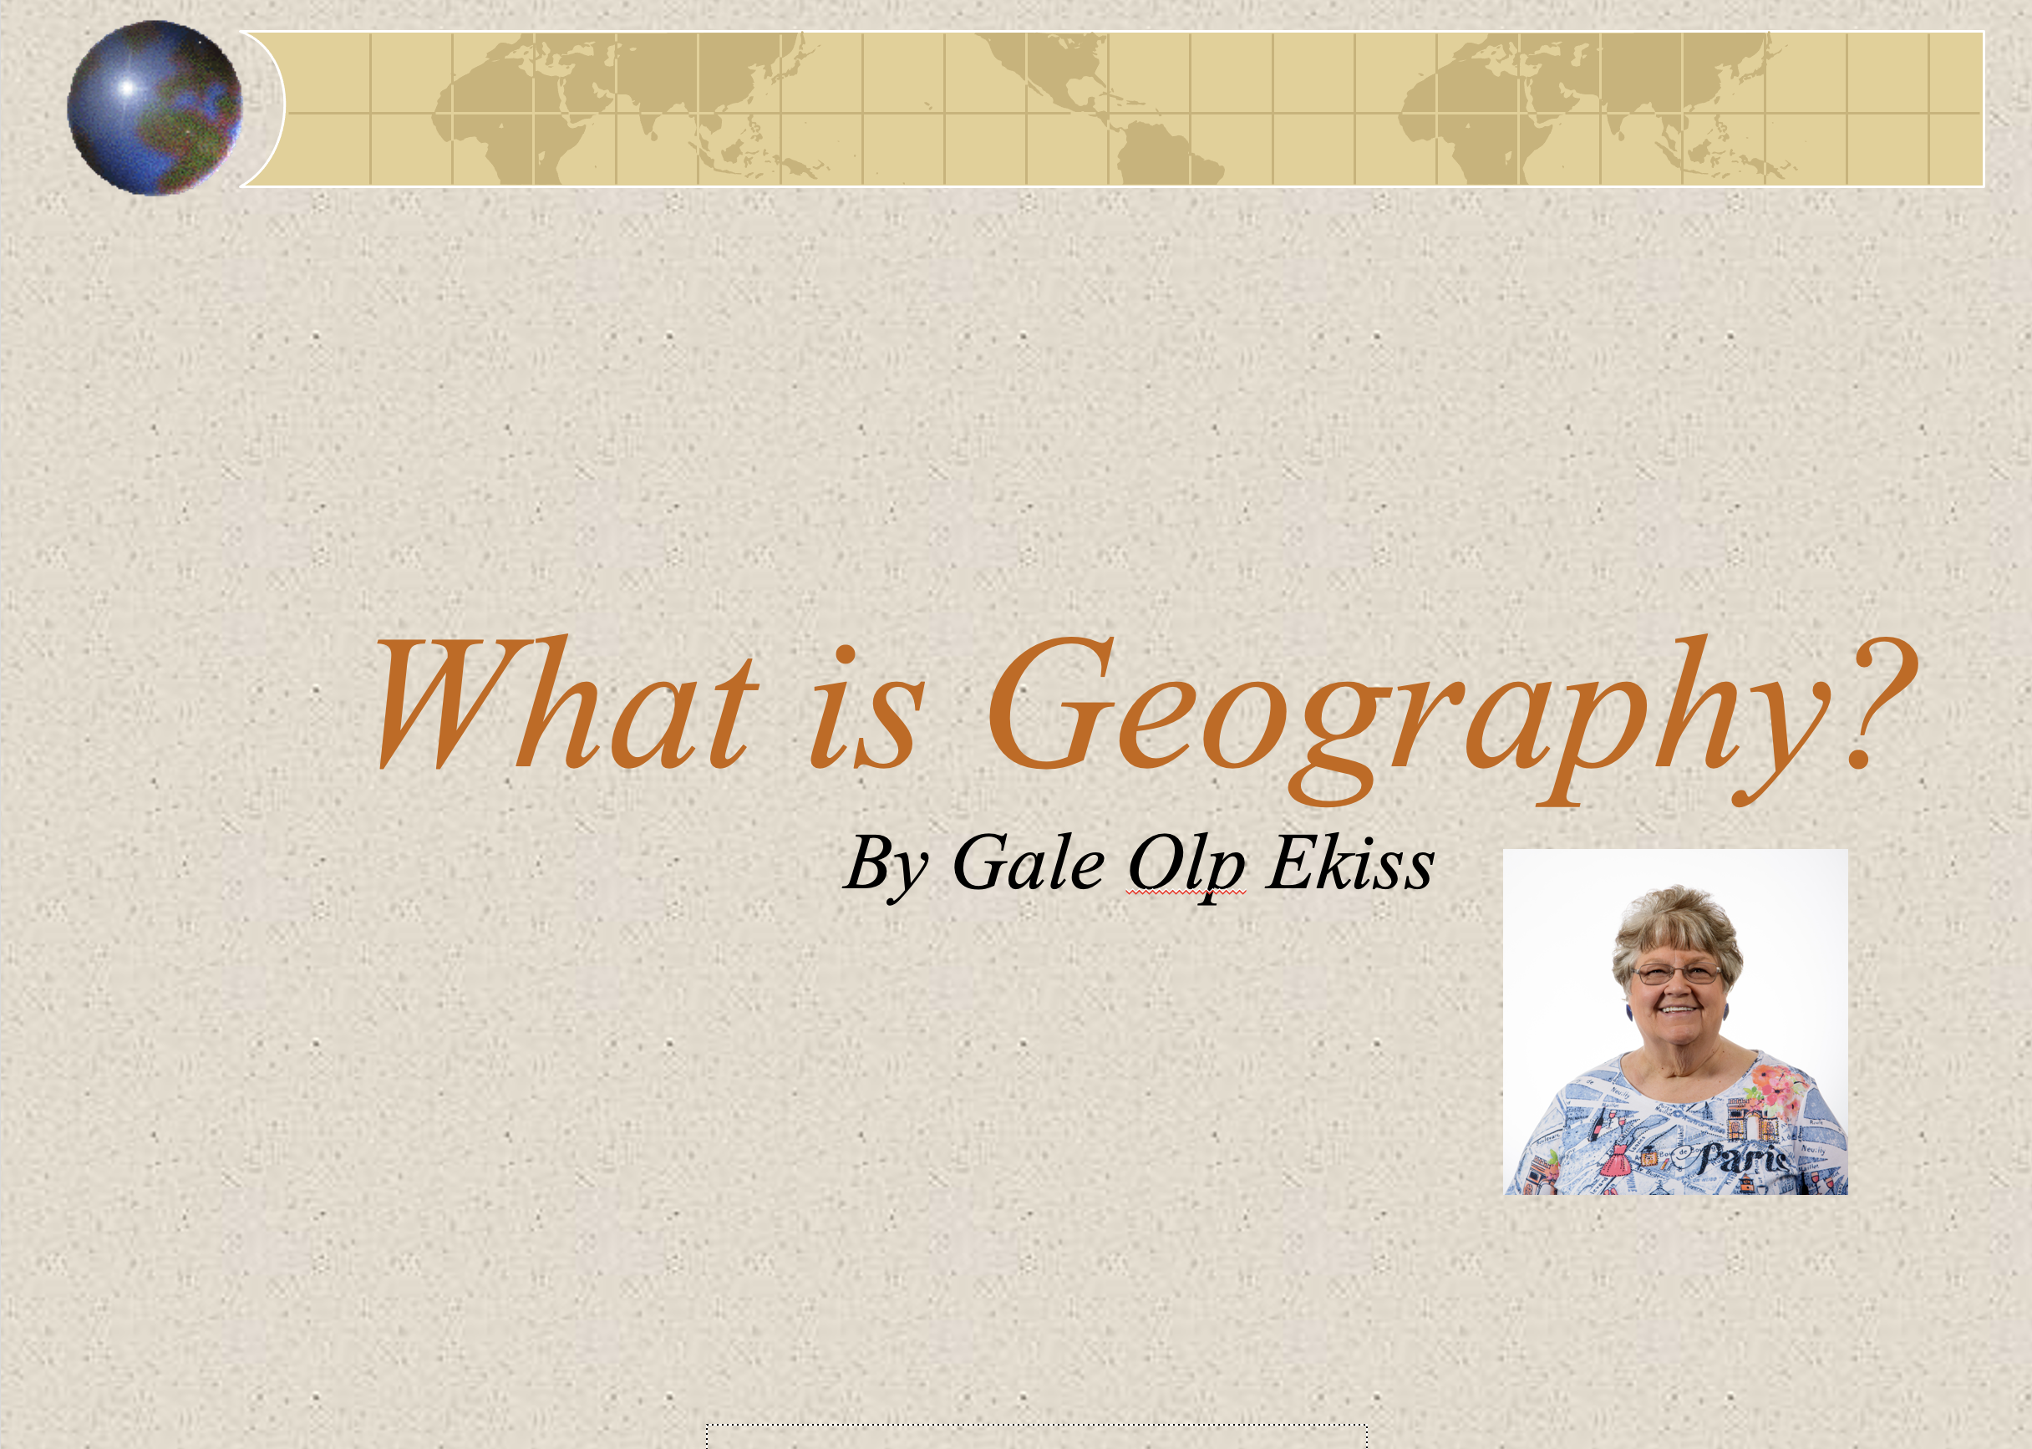
5 Themes of Geography: A Basis for Understanding Geography
By Alliance Teacher Consultants
Procedures:
1. Review ”What is Geography?”
https://geoalliance.asu.edu/5Themes

Slide 27
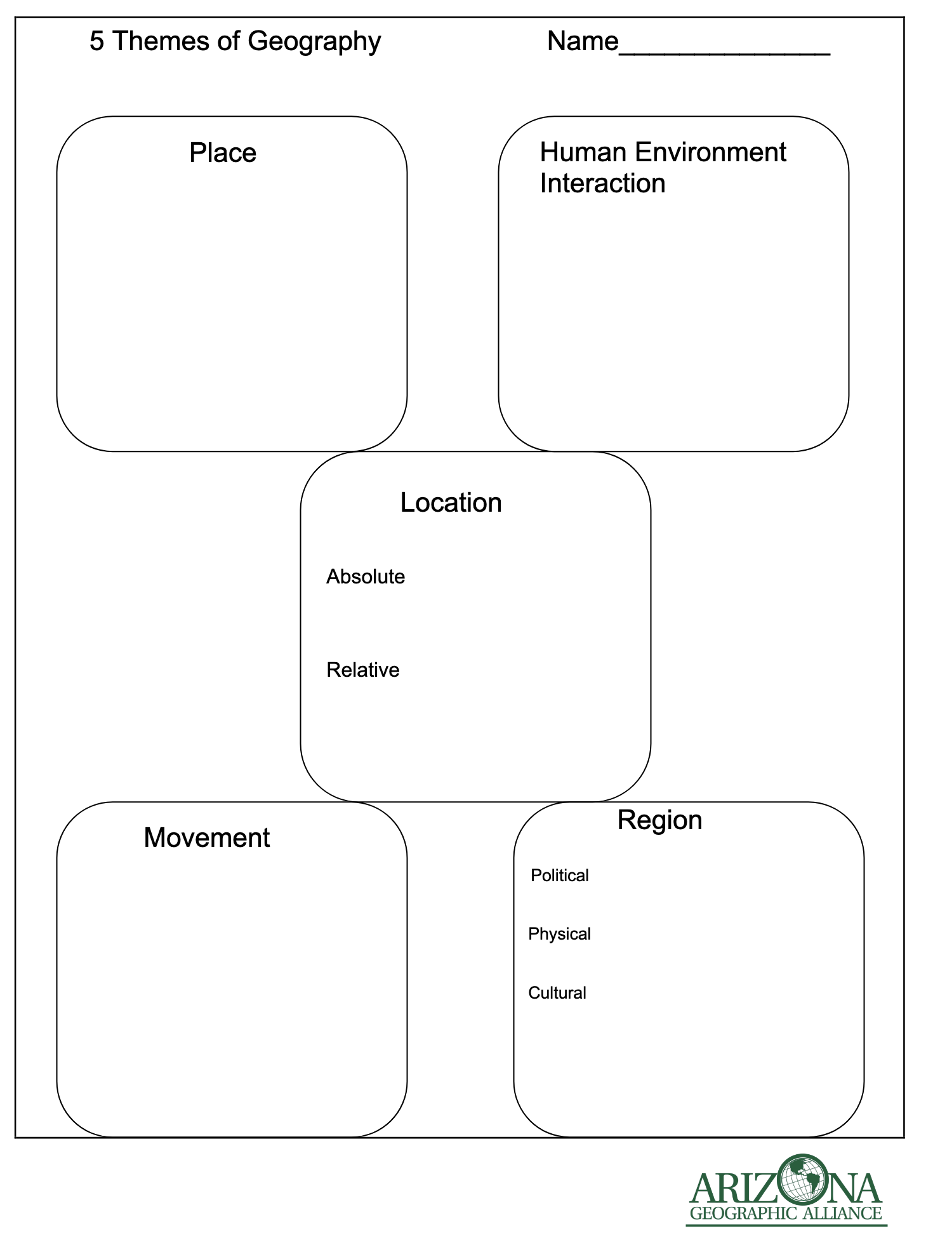
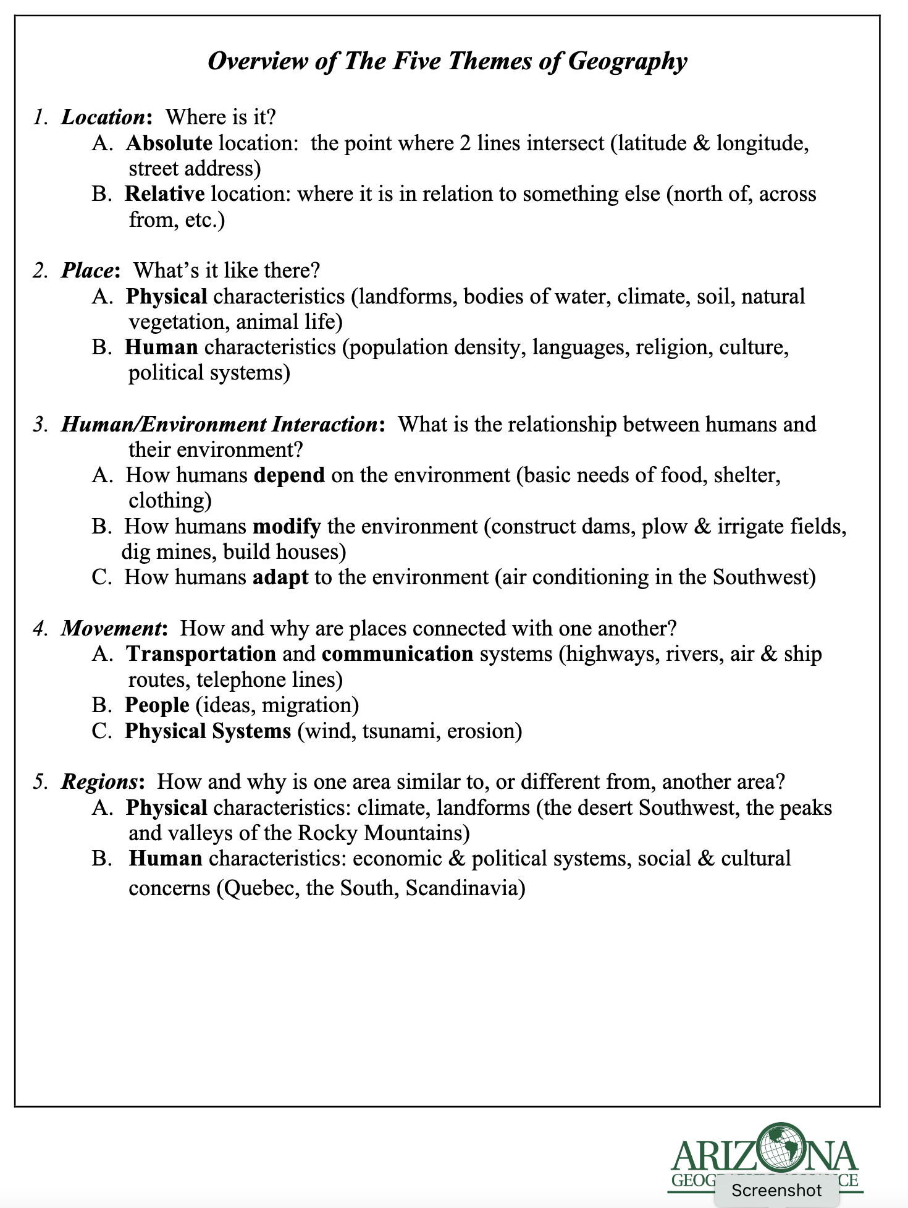
5 Themes of Geography: A Basis for Understanding Geography
By Alliance Teacher Consultants
Grades 5-High School
Session One and Two
Procedures:
2. Explain the 5 Themes and complete the Graphic Organizer

Slide 28
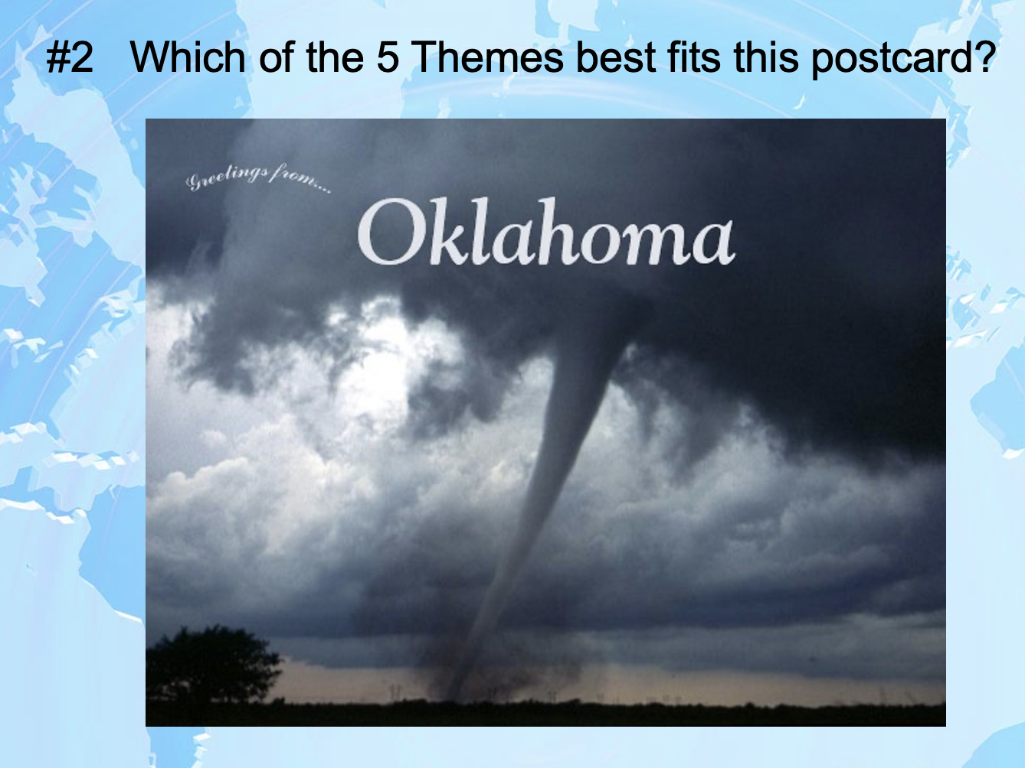
5 Themes of Geography: A Basis for Understanding Geography
3. Practice the 5 Themes using Postcards.
10 Postcards for each small group. They will identify which of the 5 Themes is the strongest based on visual evidence.
Groups share 1-2 of their cards with class and state the theme they decided upon.
Class gives thumbs up or down.
You are the judge.

Slide 29


5 Themes of Geography: A Basis for Understanding Geography
By Alliance Teacher Consultants
4. Give small groups 5 blank index cards and have them decide on 1 state, region, or country. They will create a postcard for each of the 5 themes reflecting what they know or have researched about that part of the world.
An example using Arizona as the one place or region follows:
On picture side:
Card 1 Place: drawing of the Grand Canyon or a cactus
Card 2 Location: map of Arizona showing nearby states or latitude and longitude
Card 3 Region: map of the Southwest or drawing of the Sonoran Desert
Card 4 Human Environment Interaction: drawing of people water skiing or an open pit mine
Card 5 Movement: drawing of immigrants coming to Arizona or map of major highways
On the writing side:
The students would identify the picture in a sentence or two as if this postcard is being sent to a friend. Student should address the card appropriately. (Each student in the group with the same address and recipient.)
Place
https://www.pbs.org/parents/printables/lets-go-luna-postcards

Slide 30
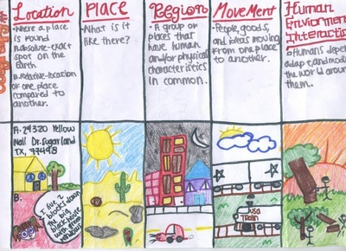
5 Themes of Geography: A Basis for Understanding Geography
By Alliance Teacher Consultants
5. Have groups share their postcards.
6. Give 5 Themes Quiz
7. Use this vocabulary throughout the year.
https://mrebbers.weebly.com/continents-and-oceans.html

Slide 31
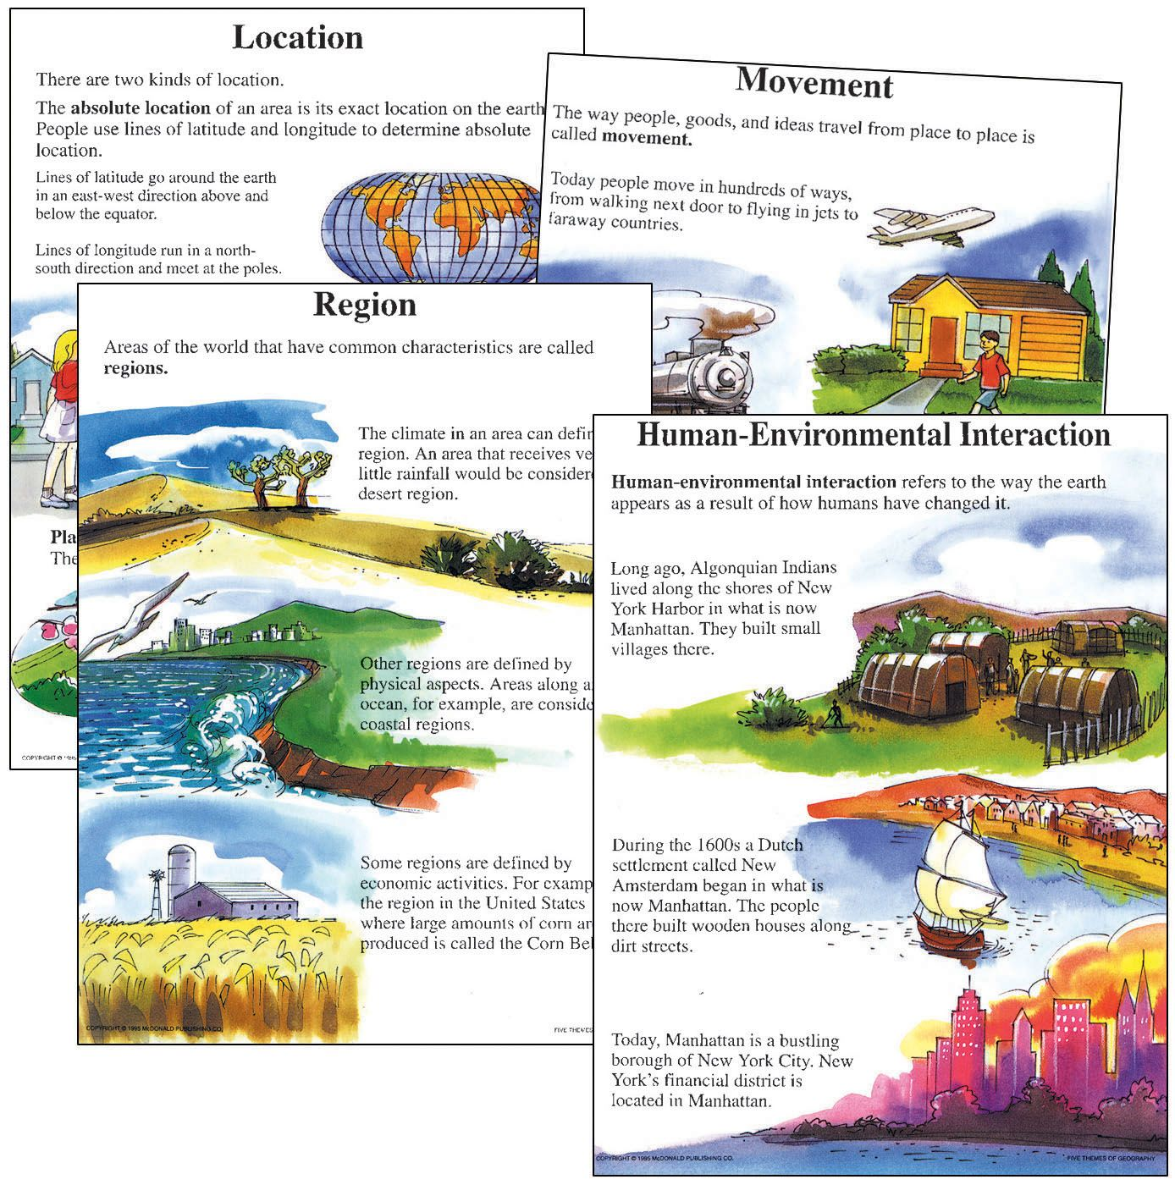
5 Themes of Geography: A Basis for Understanding Geography
By Alliance Teacher Consultants
In the Chat Box, write whether you would use this lesson in your classroom.
Yes
No
https://digitales.com.au/blog/wp-content/custom/japan-s-impact-on-japan/5-themes-of-geography-projects.php

Slide 32
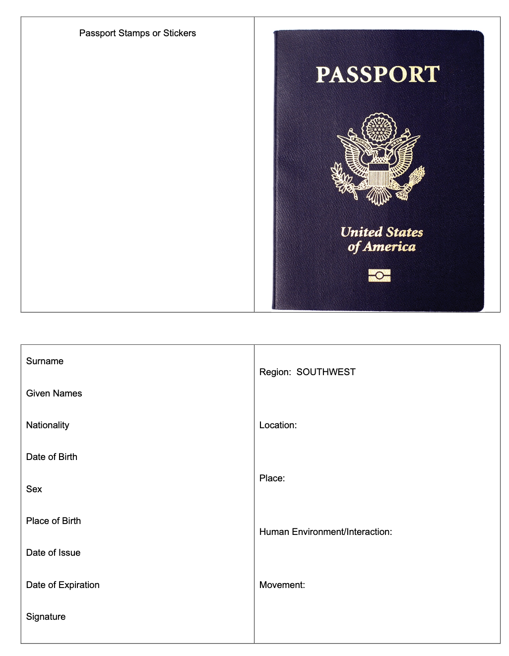
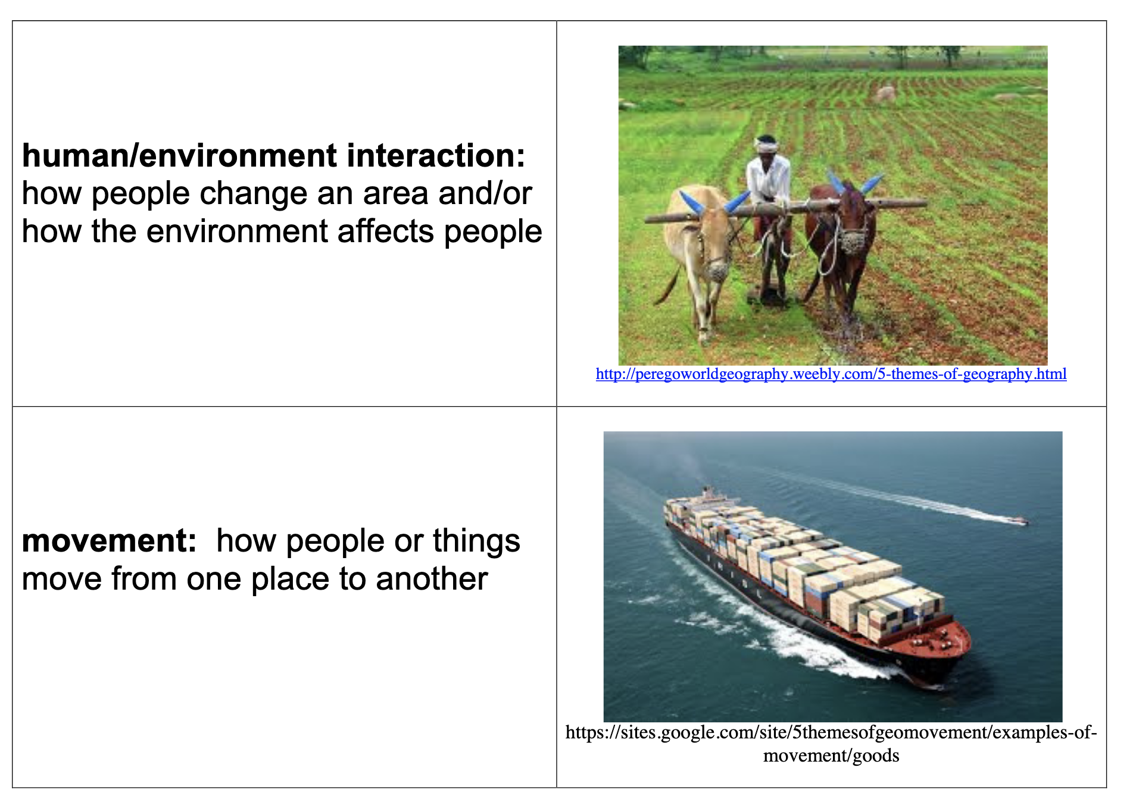
Read the Usa: Passport to Regions
By Sara Jenkins
Procedures:
1. Discuss what a passport is and assemble a paper copy of one.
2. Review 5 Themes using vocabulary cards.

Slide 33


Read the Usa: Passport to Regions
By Sara Jenkins
3. Identify on a US map the Southwest region.

Slide 34

Read the Usa: Passport to Regions
By Sara Jenkins
Procedures:
4. Explain that they will be traveling to the Southwest through a story about Alejandro. They will be looking for the 5 Themes of Geography as they listen to the story and writing one example of the theme on their passport.
5. Read the book or project the video. https://www.youtube.com/watch?v=AMIU4lTMQLw

Slide 35

Read the Usa: Passport to Regions
By Sara Jenkins
6. Model one example of the 5 Themes for the students.
7. When a student completes a passport, a stamp can be given.
8. Continue throughout the year by adding pages to the passport and learn about other regions, states, and countries.
$8.29 Oriental Trading Co.
There is an audio-visual presentation of this lesson:

Slide 36


So that the Desert Can Blossom Like a Rose: Agriculture in the Desert
BY Carol Carney Warren
Children’s Literature and 5 Themes

Slide 37


Monsoon Days
BY Gale Olp Ekiss

Slide 38

Read the Usa: Passport to Regions
By Sara Jenkins
In the Chat Box, write whether you would use this lesson in your classroom.
Yes
No
$6.99 Amazon

